Slide 1
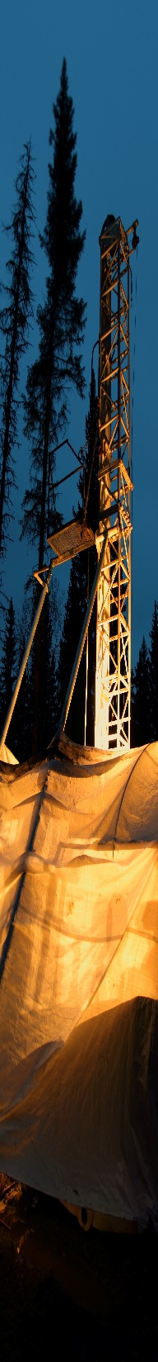


Kate Rubingh
Research Associate, Metal Earth
Harquail School of Earth Sciences, Laurentian University
Crustal architecture and auriferous fault systems from the Larder Lake transect
PDAC, February 29, 2020

Slide 2
Outline of Presentation
Part 1: Orogenic Gold deposits and gold endowment
Part 2: Fault zones and remobilization of gold
- Models for the Larder Lake - Cadillac Deformation zone
Part 3: Geology of the Larder Lake area
Part 4: Structures associated with gold mineralisation
Part 5: Expression of fault systems using Geophysics
Part 6: Conclusions – and metallogenic implications

Slide 3
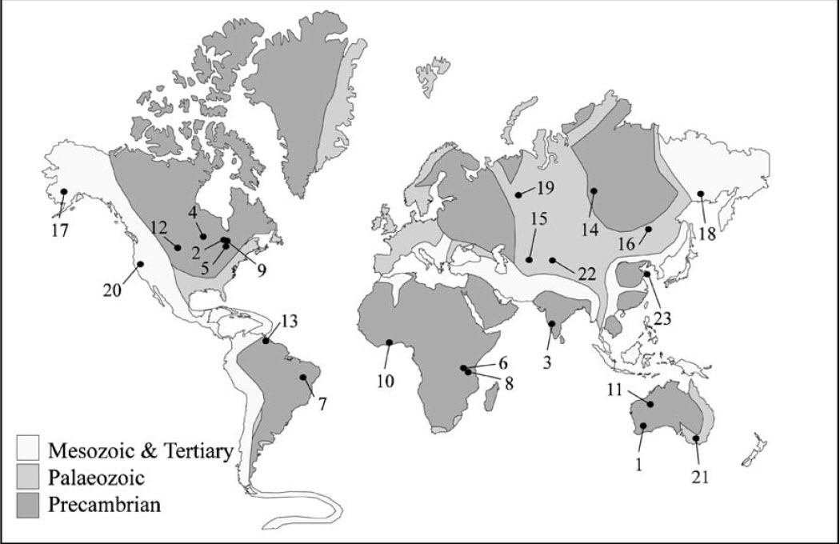
Part 1: Orogenic Gold Deposits and gold endowment
Location of Giant Orogenic Gold Deposits
Modified after Bierlein et al. (2006)
Notes:
Map showing distribution of Archean, Proterozoic, Paleozoic and Mesozoic terrranes
With the location of the 23 giant orogenic gold deposits / districts
Red circle highlights location of the major gold districts in the Abitibi Sub province of the Archean Superior Province Canada
This talk will be centred on the Abitibi

Slide 4
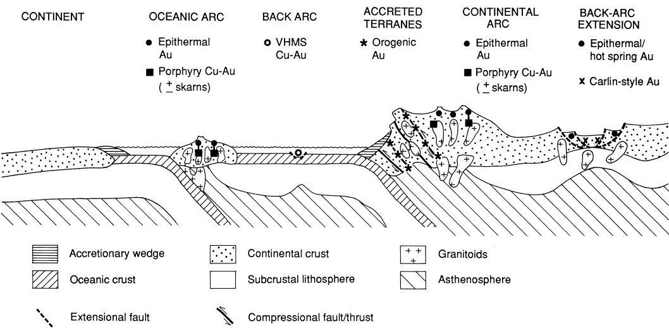
Tectonic setting
Modified after Groves et al. (1998)
Notes:
Orogenic gold deposits are emplaced during compressional to transpressional regimes throughout the uppermost crust in deformed accretionary belts adjacent to continental magmatic arcs.
Are associated with major structures.

Slide 5
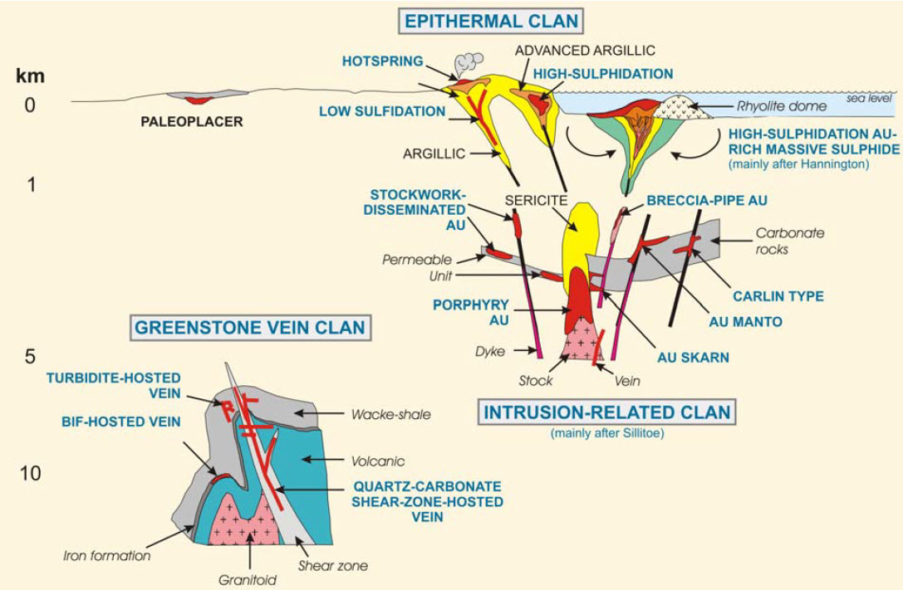
Inferred depth of emplacement of gold deposits
Orogenic gold deposits are gold-only deposits.
Gold is hosted in quartz-carbonate veins and altered wallrocks
Modified after Dubé et al. (2001)
Notes:
Note that Groves’ model considers the formation of orogenic gold deposits to have formed over an interval of 25 km from sub-greenschist (3 km) to lower granulite (>12km) levels using fluids generated during granulitization of the lower crust and/or melting of the subducted slab. Thus this figure is an inferred depth.

Slide 6
Key Characteristics of Orogenic Gold Deposits
    Tectonic setting: compressional to transpressional regimes
    Associated with shear zones and fault systems
    Emplaced over depths of >3 - 10 km
    Sulphide minerals: pyrite, arsenopyrite, pyrrhotite
    Alteration minerals: Sericite-ankerite-albite-chlorite
    Metal association: Au, Ag, As, B, Mo, W, Bi, Te, minor Cu, Pb, Zn
    Ore fluids: aqueous-carbonic, near neutral pH, slightly reduced, dominated by sulfide complexes
    Size and Grade: 1- 10 Mt of ore @ 5-10g/t Au; most are 25 – 100t Au, and many are >250t Au
Notes:
Deposition at temperatures of 300°C ± 50°C and depth of 3 – 10 km
Tabular to cylindrical in shape with steep dips and plunges

Slide 7
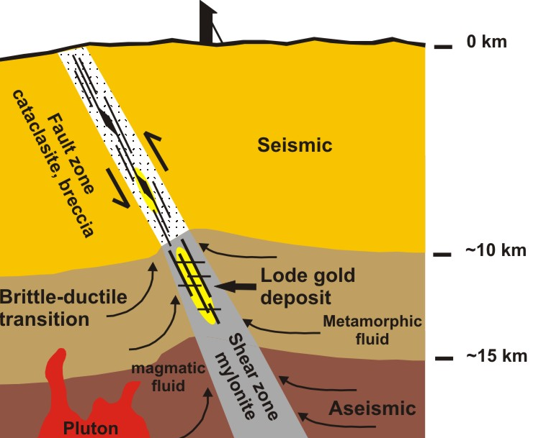
Part 2: Fault zones and remobilization of gold
Fault / Shear Zone model
Gold deposits are located along faults/ shear zones
These act as permeable conduits to channel the upward migration of large volumes of hydrothermal fluids
Fluids are derived from metamorphic dehydration reactions, plutonic /mantle sources.
Modified after Sibson et al. (1987)

Slide 8
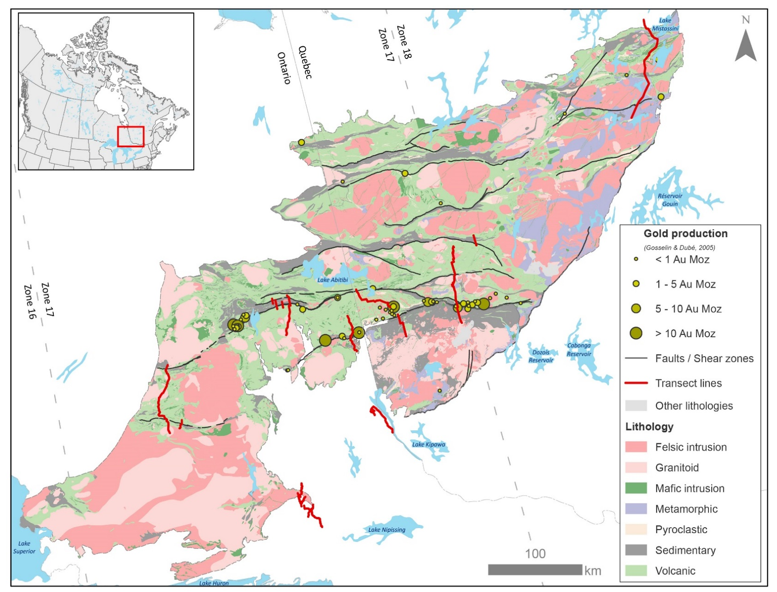
Gold endowment of the Southern Abitibi
Association of major gold deposits and fault systems
Location of the Larder Lake Cadillac Deformation Zone
- associated with
>112 Moz of Au
Val d’Or
Timmins-Porcupine
Kirkland Lake
Larder lake

Slide 9
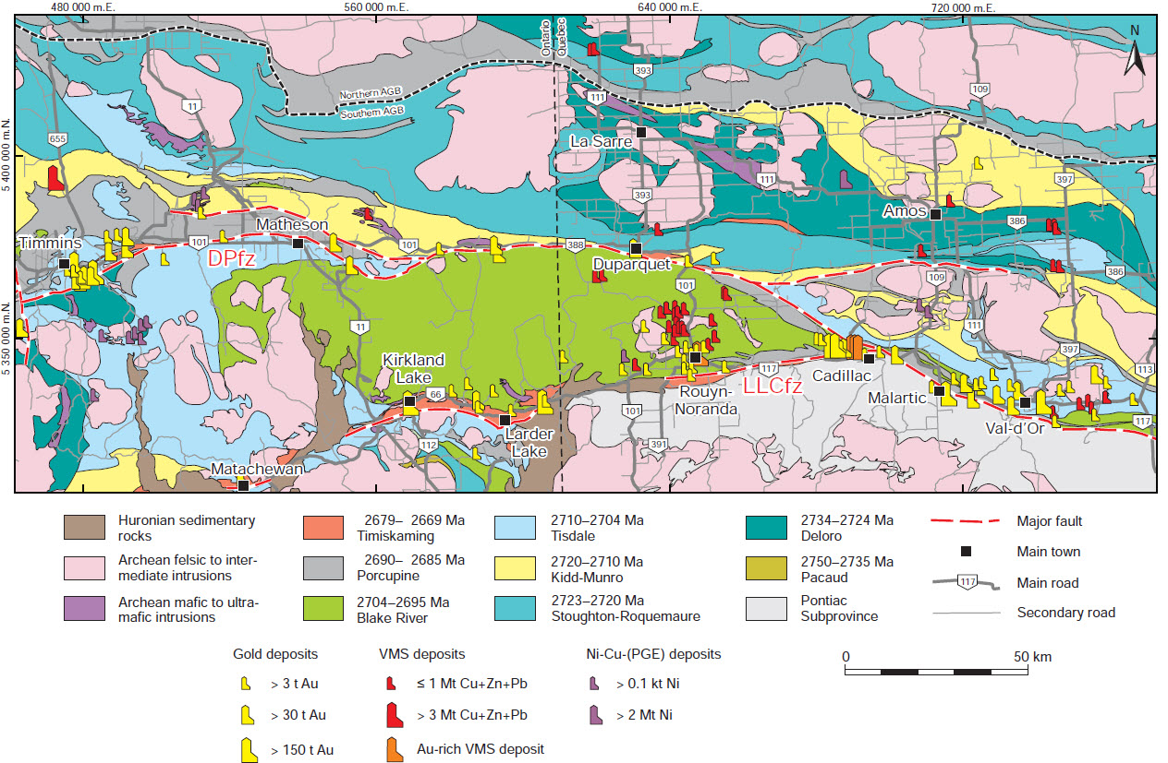
Regional Geology - Sequence of Deformational Events
LLCDZ
after Poulsen et al. (2017)

Slide 10
Regional Geology - Sequence of Deformational Events
Early folding of the volcanic rocks of the Blake River Group pre-Timiskaming deposition
Regional folding with axial planar foliation – the main regional foliation is intensified within the LLCDZ, where it becomes the foliation marking the deformation zone
Late dextral reactivation of the LLCDZ

Slide 11
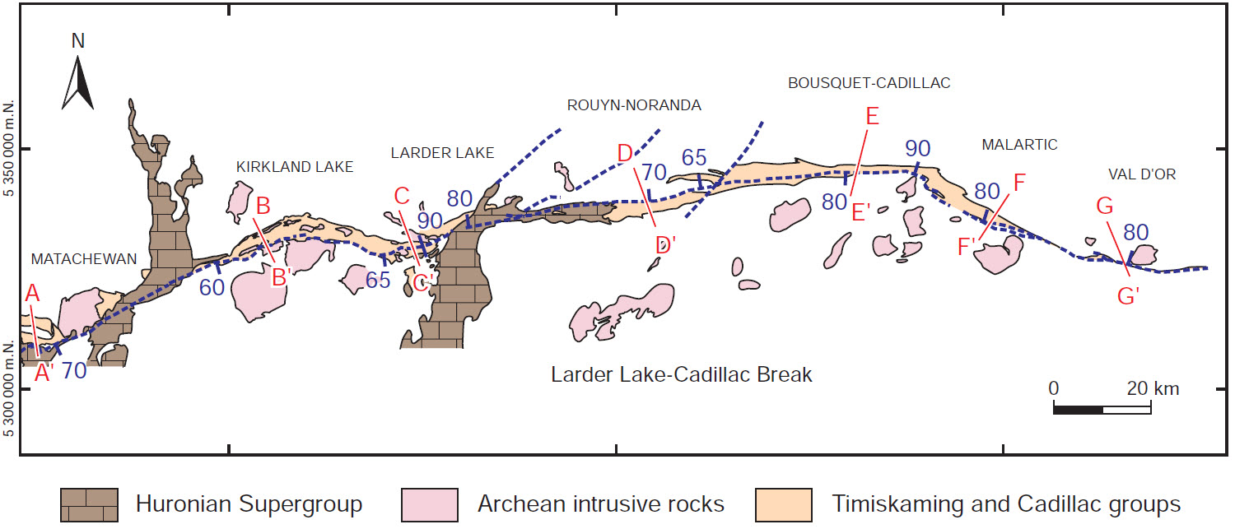
Models for the Larder Lake Cadillac Deformation zone
after Poulsen et al. (2017)
What is the nature of the Larder Lake Cadillac Deformation zone?
Cameron, 1993; Bleeker, 2012
Wilkinson, 1999
Bédeaux, 2018

Slide 12
Cameron and Bleeker’s model
Extension and basin subsidence
Modified after Cameron 1993,Bleeker, 2012

Slide 13
Cameron and Bleeker’s model
Thrusting and rapid deepening of
the basin
Evolution of the major reverse
faults into Transcurrent fault zones
Modified after Cameron 1993,Bleeker, 2012

Slide 14
Models for the Larder Lake Cadillac Deformation zone
Geometry of the LLCDZ
after Poulsen et al. (2017)

Slide 15
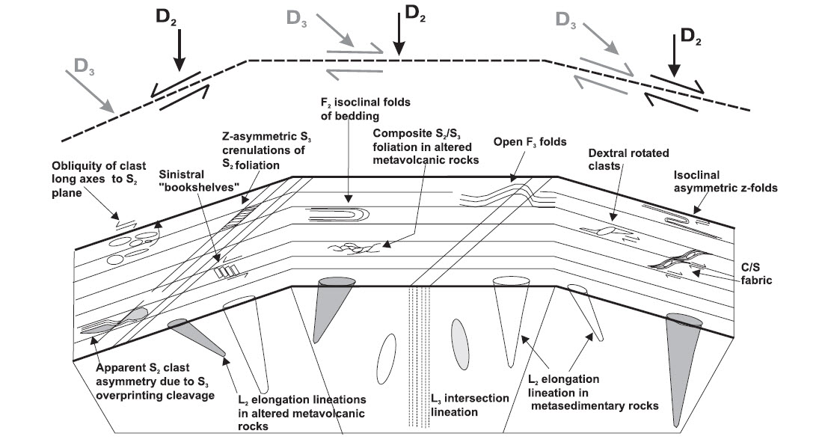
Wilkinson’s model
Geometry of the LLCDZ
Regional foliation development during transcurrent movement
- Gold deposition not associated with reverse faulting as advocated by Bleeker, 2012
Wilkinson et al. (1999)

Slide 16
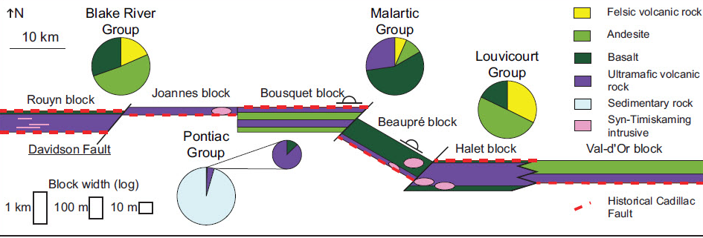
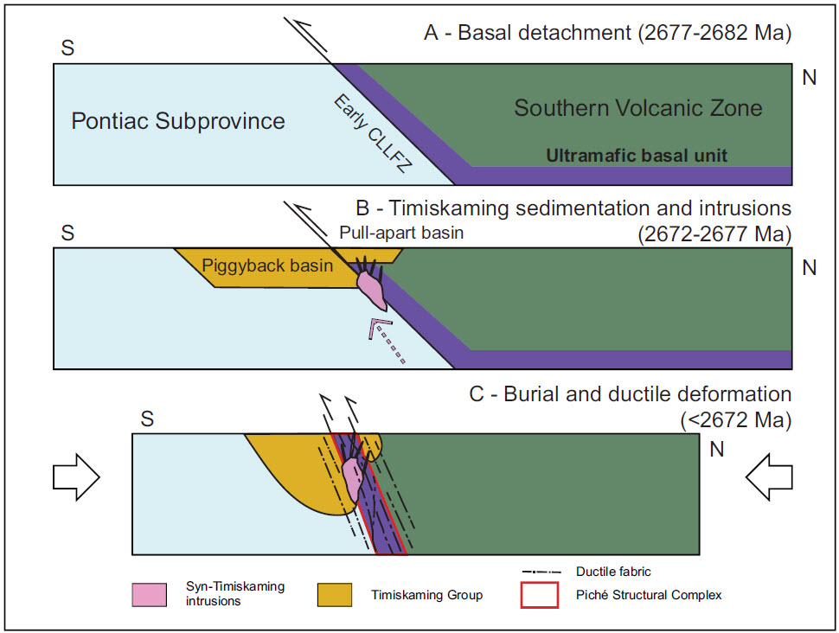
Bédeaux’s model
Bédeaux et al. (2018)
LLCDZ – an early accretionary structure juxtaposing Pontiac and Abitibi subprovinces
Subdivided into 6 segments
Linkage of segments forming the LLCDZ

Slide 17
Models for the Larder Lake Cadillac Deformation zone
LLCDZ has been interpreted as a large transcrustal scale structure
Cameron, 1993; Bleeker, 2012
- Early extensional basins - Timiskaming deposition
- Basin closure, reverse faulting and gold deposit formation
Wilkinson, 1999
Different orientation of the basin margins
Different segments respective sinistral / dextral sense of motion
Gold deposits form during transcurrent movement not reverse faulting
Bédeaux, 2018
- Linkage of segments which form the LLCDZ
Notes:
Timiskaming sediments are emplaced along extensional basins, during alkaline magmatism and enrichment of the crust, which is remobilized during reactivation and closure of the basin

Slide 18
XXXX
Part 3: Geology of the Larder Lake area
Anoki
McBean
Upper Beaver
Omega
Fernland
Cheminis
Bear Lake
Barber Larder
McGarry
Kerr Addison
3
10
1
8
9
2
4
5
6
7
Courtesy of Dr. R. Sherlock
From: Jackson, 1995, OGS Map 2628, 1:50,000
2km

Slide 19
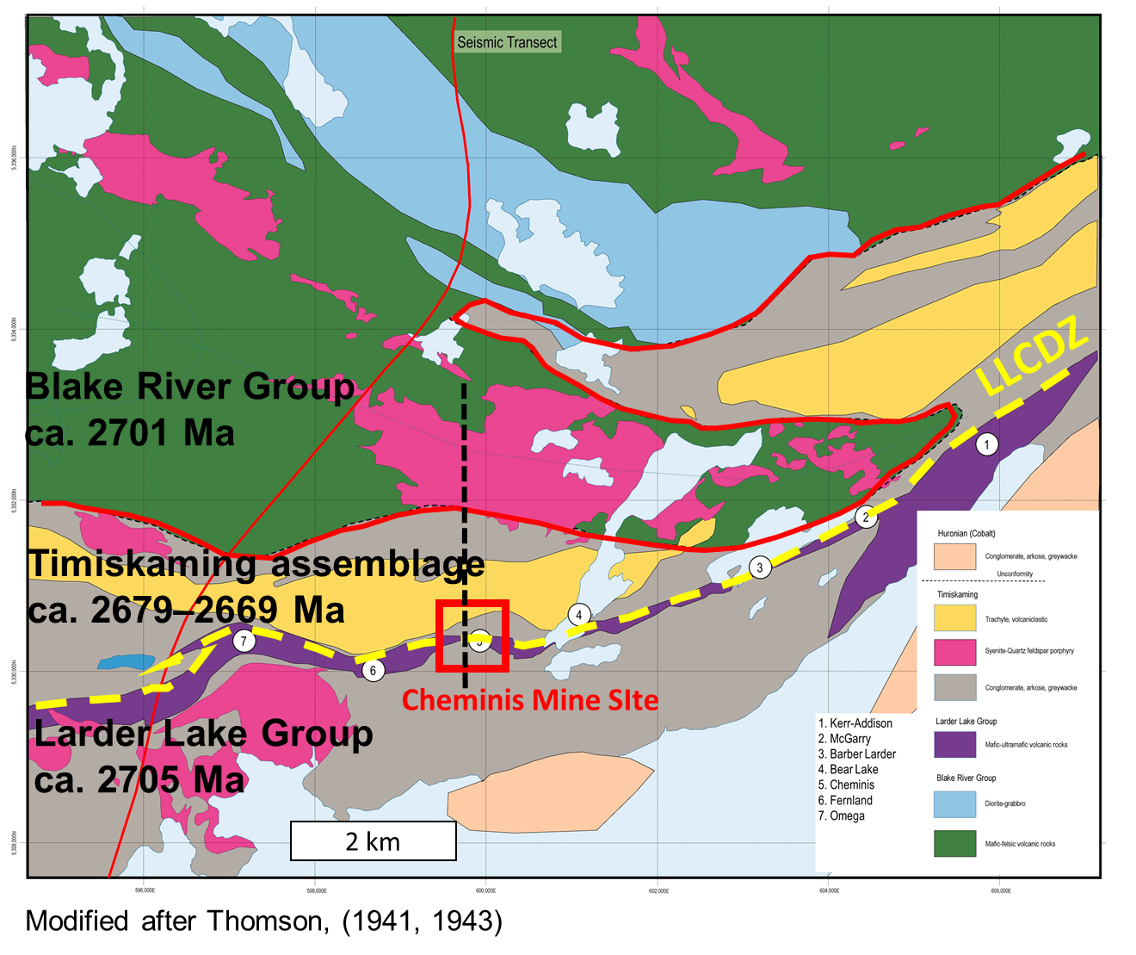
Larder Lake- Cadillac Deformation Zone (LLCDZ)
Research locations
Cheminis Mine site
Kerr Addison Mine site
- Reviewed north and south contacts of the Larder Lake Group with the Timiskaming assemblage
Modified after Thomson, (1941, 1943)
Notes:
Blake River group to north (in green)
Contact between Blake River grp. and Timiskaming ass. = unconformity.
Timiskaming ass. Fluvial-alluvial sedimentary rocks, intruded by syenite and volc equivalents trachytic volcanic rocks
Panel of UM-mafic volcanic rocks, Larder lake grp – (in purple)
Contact b/w Tim seds and Larder Lake grp is C-LL break which controls distribution of gold deposits
Cadillac-Larder Lake break
Contact between Timiskaming ass. and Larder Lake grp. = C-LL break

Slide 20
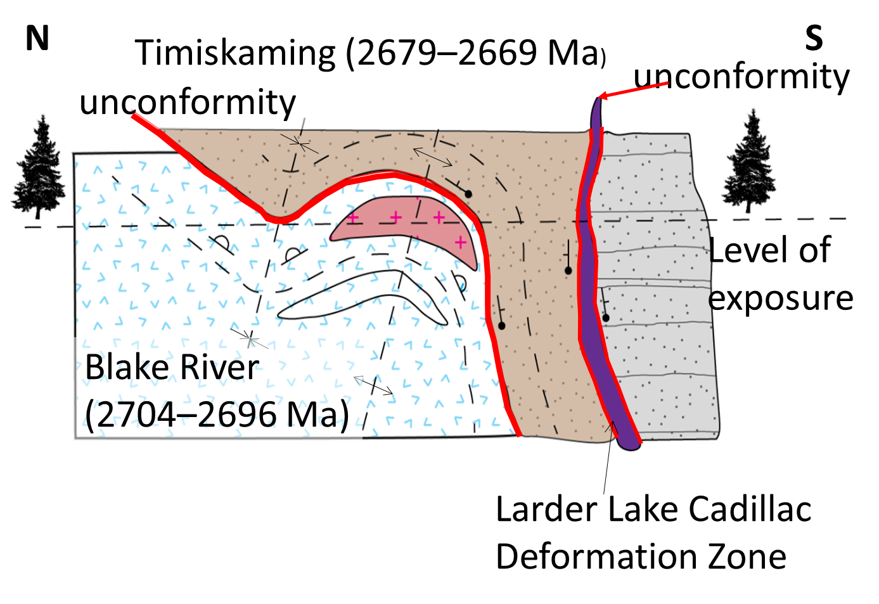
Part 4: Structures associated with gold mineralization
Cross section - LLCDZ
Unconformity
Unconformity
Timiskaming (2679 – 2669 Ma)
Level of exposure
Blake River (2704 – 2696 Ma)
Larder Lake Group (Piché equivalent) (ca. 2710-2704 Ma)
Modified after Poulsen, 2017
LLCDZ
Notes:
Structural juxtaposition between the Blake River and Larder Lake groups
Contact between Blake River grp. and Timiskaming ass. = unconformity.
Contact between Timiskaming ass. and Larder Lake grp. = C-LL break

Slide 21
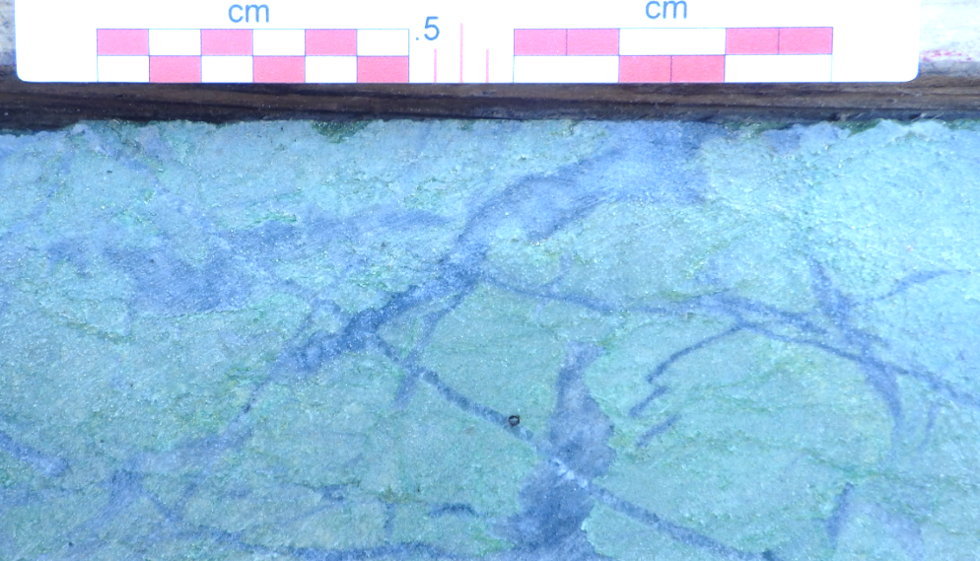
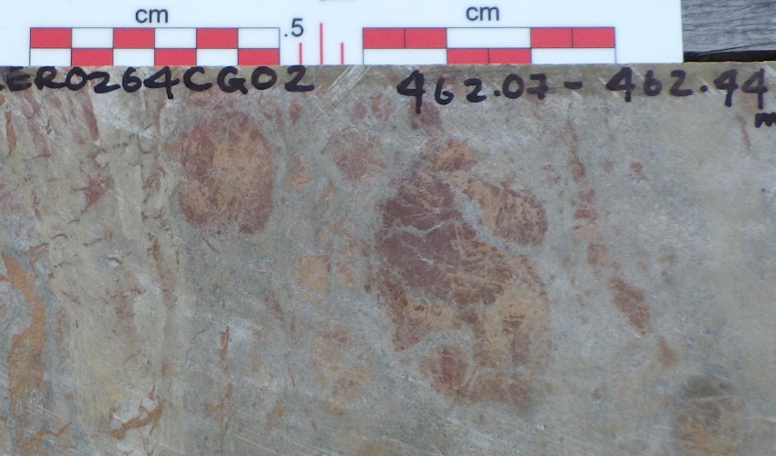
Larder Lake Cadillac Deformation Zone
Northern contact between Larder Lake Group and Timiskaming assemblage
Fuchsite altered ultramafic
‘green carbonate zone’
Transition zone - rounded mafic to ultramafic fragments
composed of chlorite-carbonate-quartz-albite in a quartz and sericite-rich siltstone matrix
Notes:
Transition zone between Larder Lake group and Timiskaming assemblage
Carbonatized, rounded to subrounded fragments in Timiskaming sedimentary matrix.
Drillholes across northern contact between Larder Lake Group ultramafic flow (fuchsite altered) and Timiskaming sediments
Fragmental unit at contact and graded beds younging downhole (to the north, away from ultramafic flow).
Details of the contact
Facing away from LL grp. And transition zone, well defined with clasts of UM detritus in a clastic matrix
Often the higher strain zones are in FW of contact
Implication is that the larder lake grp, time equivalent of the Tisdale was the basement for development of the Timiskaming basin
Is the ancestral fault that controls the deposits, really the reactivation of the fault that juxtaposes the Larder lake group (Tisdale and the Blake River grp)
Subsequent deformation resulted in Au
Notes on photos
Photomicrograph of fragmental unit at the Timiskaming – Larder Lake Group contact.
Rounded mafic to ultra mafic fragments, composed primarily of chlorite-carbonate-quartz-albite in a quartz and sericite-rich siltstone matrix

Slide 22
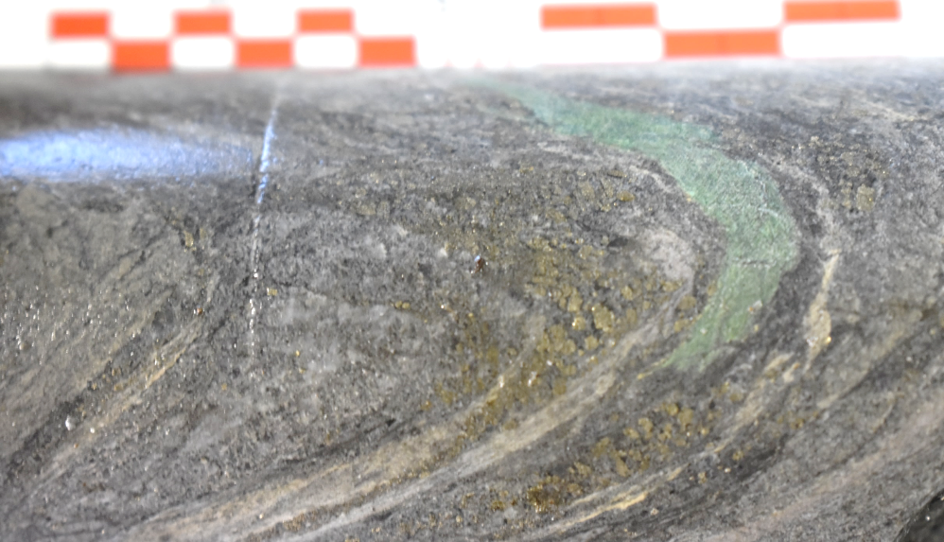
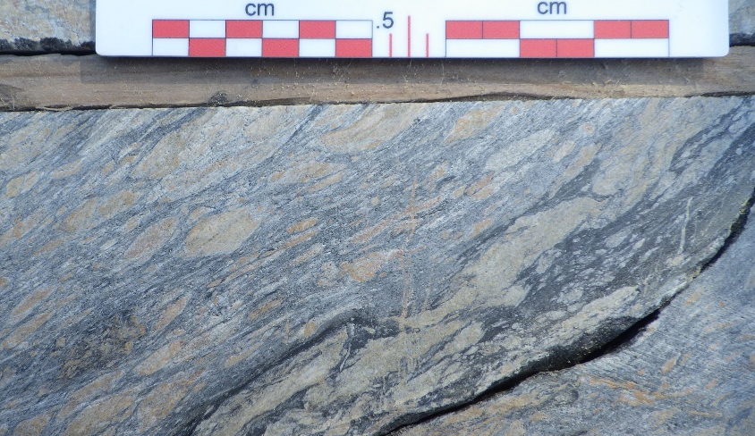
Larder Lake Cadillac Deformation Zone
Fuchsite altered ultramafic
clasts in Timiskaming
sedimentary rocks at the
‘transition zone’
Flattened mafic to ultramafic fragments in the transition zonr
Notes:
Transition zone between Larder Lake group and Timiskaming assemblage
Carbonatized, rounded to subrounded fragments in Timiskaming sedimentary matrix.
Drillholes across northern contact between Larder Lake Group ultramafic flow (fuchsite altered) and Timiskaming sediments
Fragmental unit at contact and graded beds younging downhole (to the north, away from ultramafic flow).
Details of the contact
Facing away from LL grp. And transition zone, well defined with clasts of UM detritus in a clastic matrix
Often the higher strain zones are in FW of contact
Implication is that the larder lake grp, time equivalent of the Tisdale was the basement for development of the Timiskaming basin
Is the ancestral fault that controls the deposits, really the reactivation of the fault that juxtaposes the Larder lake group (Tisdale and the Blake River grp)
Subsequent deformation resulted in Au
Notes on photos
Photomicrograph of fragmental unit at the Timiskaming – Larder Lake Group contact.
Rounded mafic to ultra mafic fragments, composed primarily of chlorite-carbonate-quartz-albite in a quartz and sericite-rich siltstone matrix

Slide 23
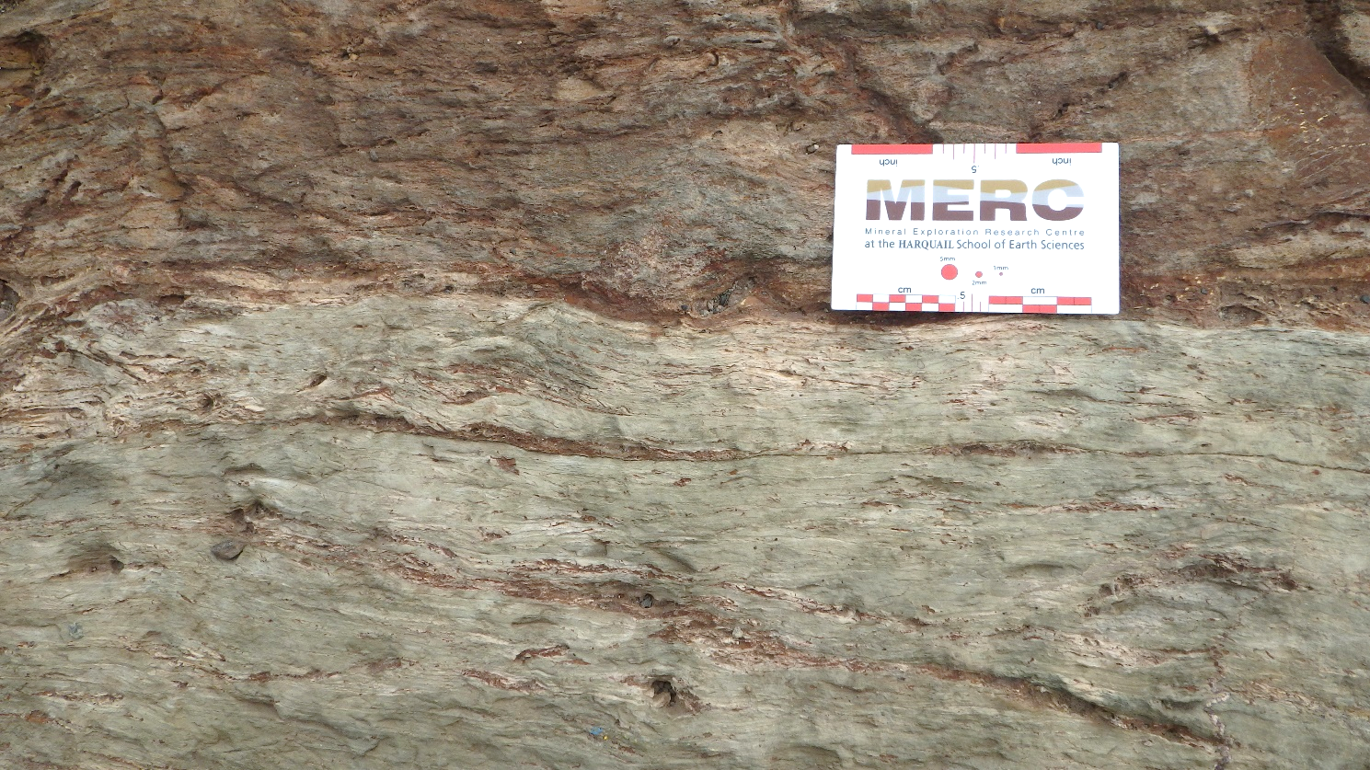
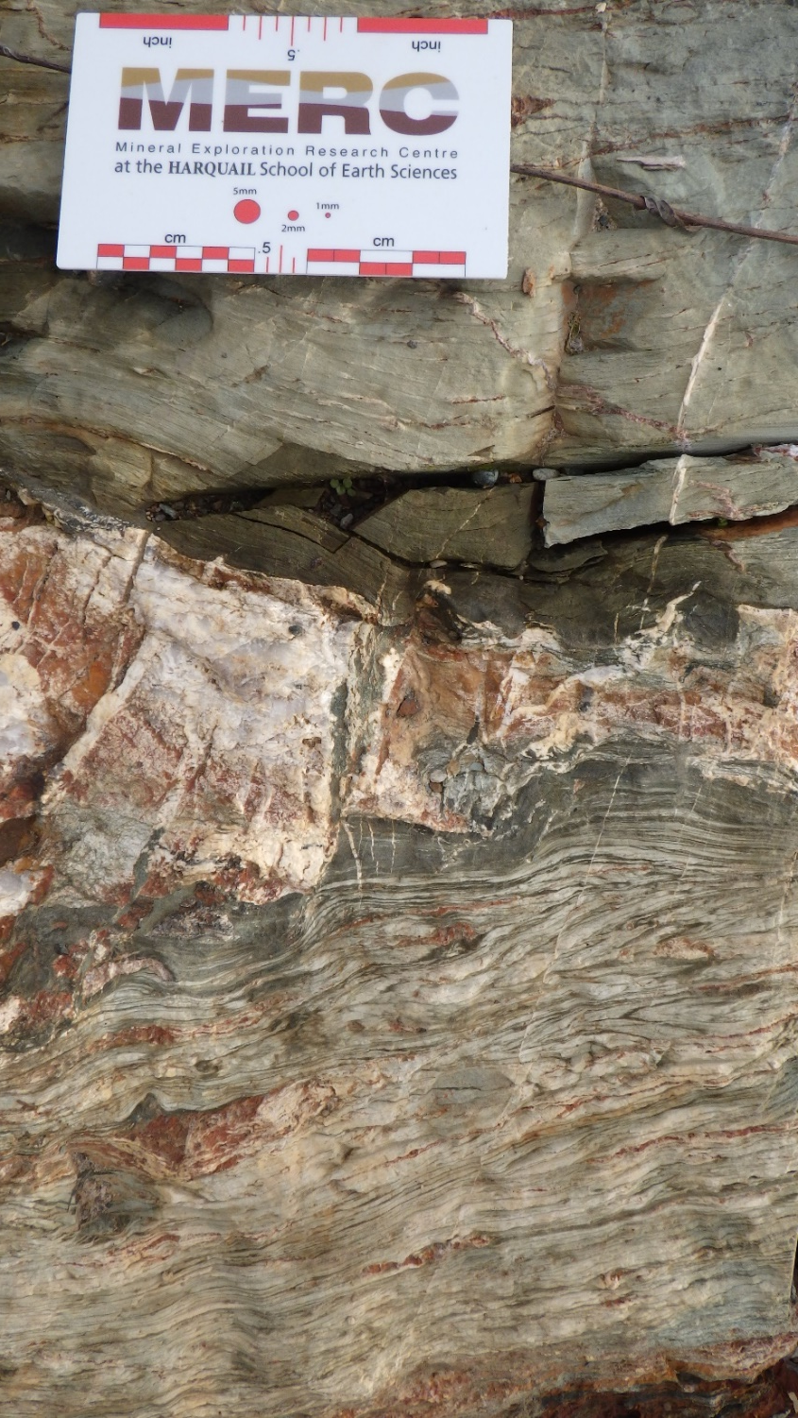
Larder Lake Cadillac Deformation Zone
Southern contact between Larder Lake Group and the Timiskaming assemblage
Greywacke to siltstone in sharp contact with strongly carbonatized mafic to ultramafic volcanic rocks
Facing directions are to the south, away from the Larder Lake Group
Notes:
At the south contact, a very fine-grained greywacke to sandstone is in sharp contact with intercalated mafic to ultramafic volcanic flows to the north. The greywacke is green to grey with consistent graded beds, younging to the south, away from the Larder Lake group volcanic rocks.
Locally, the sediments contain bedding parallel layers of strongly carbonatized material that appears to be mafic layers. The ultramafic rocks, bounded to the north and south by sedimentary rocks, are dark green, very fine grained and have been strongly carbonatized. Locally, monomict breccia textures are observed in the ultramafic volcanic flows with a strongly carbonatized matrix and chloritic clasts. Geochemically, these volcanic units are classified as komatiitic basalts.
The contact between the two lithologies varies from sharp, with no obvious structure or shear sense indicators and equal strain on either side, to moderately strained, with sheared and attenuated sedimentary beds proximal to the contact. Unlike the north contact no transitional zone containing ultramafic-mafic clasts is recognized.
Details of the contact
Facing away from LL grp. And transition zone, well defined with clasts of UM detritus in a clastic matrix
Often the higher strain zones are in FW of contact
Implication is that the larder lake grp, time equivalent of the Tisdale was the basement for development of the Timiskaming basin
Is the ancestral fault that controls the deposits, really the reactivation of the fault that juxtaposes the Larder lake group (Tisdale and the Blake River grp)
Subsequent deformation resulted in Au
Notes on photos
Photomicrograph of fragmental unit at the Timiskaming – Larder Lake Group contact.
Rounded mafic to ultra mafic fragments, composed primarily of chlorite-carbonate-quartz-albite in a quartz and sericite-rich siltstone matrix

Slide 24
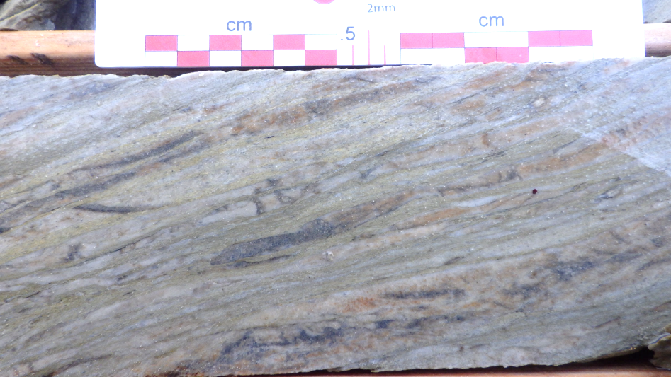
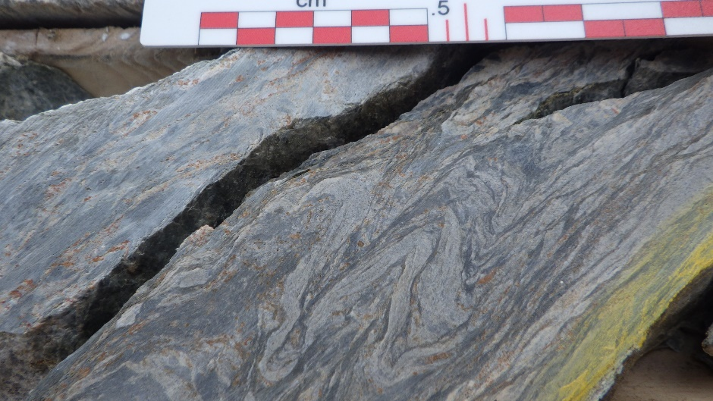
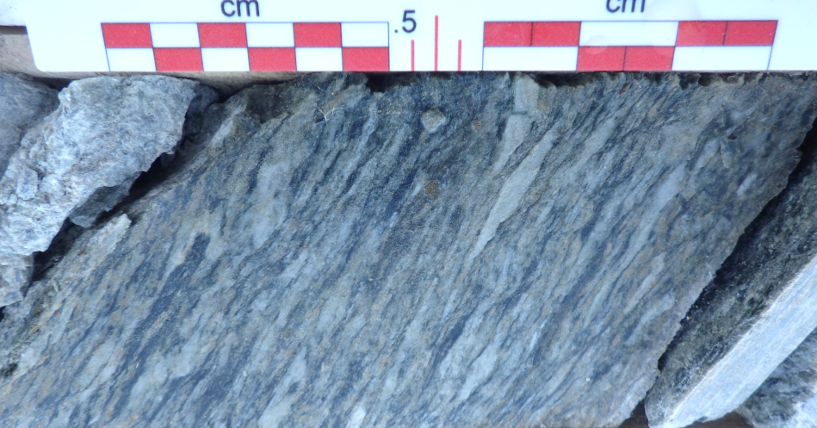
Larder Lake Cadillac Deformation Zone
Larder Lake Cadillac Deformation Zone
Moderately strained, with sheared and attenuated sedimentary beds proximal to the contact
The southern contact exhibits no transitional zone
Notes:
At the south contact, a very fine-grained greywacke to sandstone is in sharp contact with intercalated mafic to ultramafic volcanic flows to the north. The greywacke is green to grey with consistent graded beds, younging to the south, away from the Larder Lake group volcanic rocks.
Locally, the sediments contain bedding parallel layers of strongly carbonatized material that appears to be mafic layers. The ultramafic rocks, bounded to the north and south by sedimentary rocks, are dark green, very fine grained and have been strongly carbonatized. Locally, monomict breccia textures are observed in the ultramafic volcanic flows with a strongly carbonatized matrix and chloritic clasts. Geochemically, these volcanic units are classified as komatiitic basalts.
The contact between the two lithologies varies from sharp, with no obvious structure or shear sense indicators and equal strain on either side, to moderately strained, with sheared and attenuated sedimentary beds proximal to the contact. Unlike the north contact no transitional zone containing ultramafic-mafic clasts is recognized.
Details of the contact
Facing away from LL grp. And transition zone, well defined with clasts of UM detritus in a clastic matrix
Often the higher strain zones are in FW of contact
Implication is that the larder lake grp, time equivalent of the Tisdale was the basement for development of the Timiskaming basin
Is the ancestral fault that controls the deposits, really the reactivation of the fault that juxtaposes the Larder lake group (Tisdale and the Blake River grp)
Subsequent deformation resulted in Au
Notes on photos
Rounded mafic to ultra mafic fragments, composed primarily of chlorite-carbonate-quartz-albite in a quartz and sericite-rich siltstone matrix

Slide 25
Cross section - Larder Lake Cadillac Deformation Zone
North contact interpreted as an unconformity due to:-
Gradational contact between the two assemblages
Lack of a major shear zone or structure at the contact
- Consistent younging directions away from the volcanic rocks
Unconformity
Timiskaming (2679 – 2669 Ma)
Level of exposure
Blake River (2704 – 2696 Ma)
Modified after Poulsen, 2017
LLCDZ
Juxtaposition of the Timiskaming and Larder Lake Group prior to main north south shortening deformational event.
Notes:
Structural juxtaposition between the Blake River and Larder Lake groups
Contact between Blake River grp. and Timiskaming ass. = unconformity.
Contact between Timiskaming ass. and Larder Lake grp. = C-LL break

Slide 26
Lincoln Nipissing Shear Zone (LNSZ)
Lincoln Nipissing fault system
From: Jackson, 1995,
OGS Map 2628, 1:50,000
2km

Slide 27
Lincoln Nipissing Shear Zone
Unconformity at contact between clastic sediments and UM volcanic rocks
Small volume intrusive stocks
associated with gold in
stockwork veins
Skead Volc.
2km
From: Jackson, 1995, OGS Map 2628, 1:50,000
Notes:
LN fault system juxtaposes
Skead volcanic rocks against younger volc strata
Marked by peridotite – komatiite flows

Slide 28

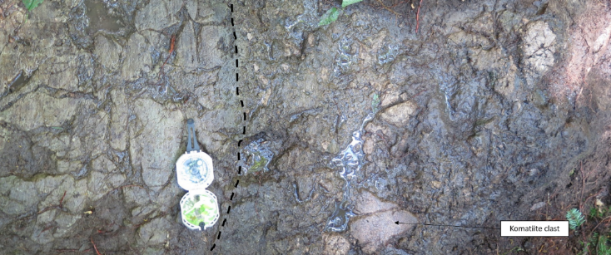
Lincoln Nipissing shear zone
Basal unconformity developed between the Larder Lake grp. (ca. 2710-2704 Ma) and the Hearst assemblage. (> ca. 2700 Ma)
Similar structural / stratigraphic relationship as the LLCDZ
A
Notes:
Basal unconformity between LL grp and Hearst
Similar stratigraphic assemblage as the C-LL break
Komatiite – (serpentinized polygonal joints)
Basal conglomerate (matrix supported, unsorted, angular clasts of veined granitoid and spinifex textured komatiites)

Slide 29
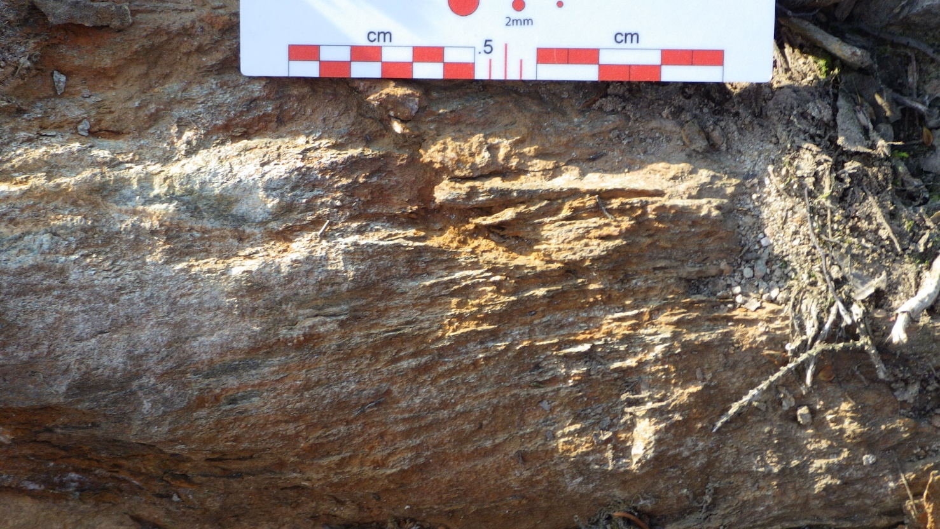
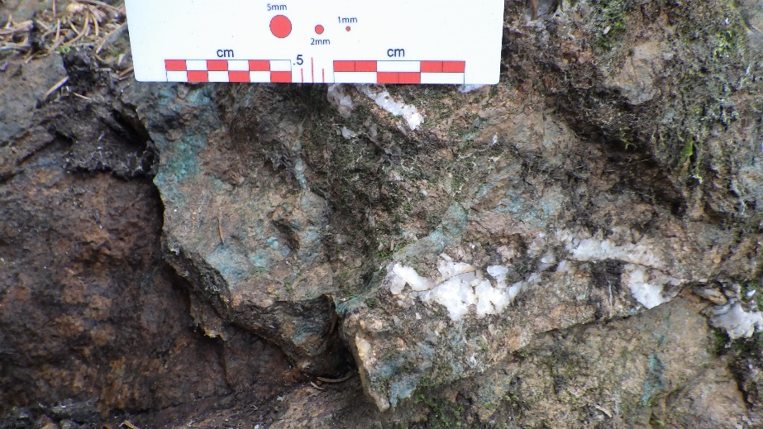
Lincoln Nipissing Shear zone
Iron carbonate alteration
Fuchsite – quartz veins

Slide 30
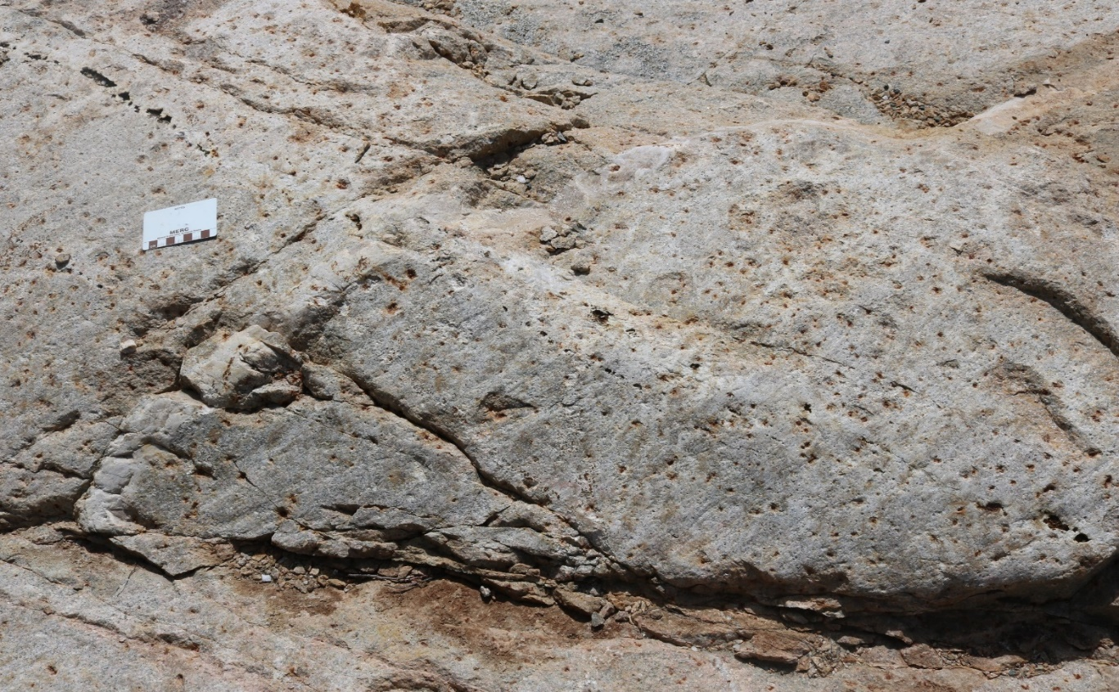
Lincoln Nipissing intrusive rocks
Represent compositionally distinct suites of rock.
The primary magmatic textures of the intrusive rocks are preserved.
The overprinting alteration is metasomatic, pervasive and affects all intrusive rocks.
The pervasive pitting of feldspars is the result of coupled dissolution and re-precipitation processes.
Significant alteration and fluid flux
Sean Brace MSc candidate

Slide 31
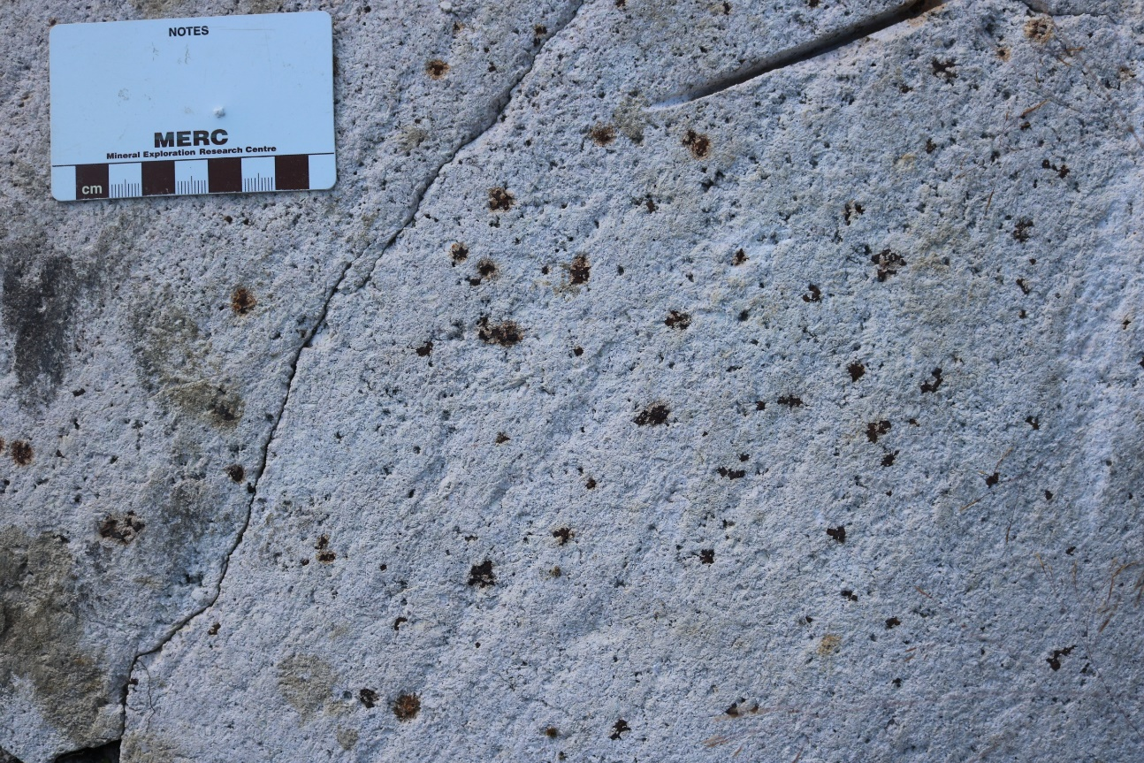
Lincoln Nipissing intrusive rocks
Intense alteration of host rocks
ca. 2675Ma ~ Timiskaming in age
Gold was located in the felsic intrusive rocks within late quartz ± carbonate veins
Sean Brace MSc candidate

Slide 32
Lincoln Nipissing Shear Zone versus the LLCDZ
Similarities
Differences
Similar structural juxtaposition of different assemblages
Similar lithologies – Ultramafic – mafic volcanic rocks and clastic sedimentary rocks.
Similar alteration:-
  Strong iron carbonate alteration, quartz and quartz – carbonate veins
  Fuchsite and sericite
Strong foliation and down dip lineation
The LLCDZ has widespread alkalic volcanic rocks intercalated with Timiskaming sedimentary rocks.
A wide damage zone is observed in the footwall of the main break
Large gold deposits (11Moz Kerr Addison) associated with the main LLCDZ.
The LLCDZ can be traced up to 30 km on the seismic section
Notes:
The LNSZ has similar characteristics to the LLCDZ in terms of structure and alteration, and there is an association of both shear zones with Timiskaming-like sedimentation, alkaline magmatism and lamprophyre dikes.
These interpretations will be further refined during the 2019 field season and follow-up work will be performed on the small-volume intrusions that stitch the LNSZ and have associated gold prospects.
Numerous gold prospects
Similar intrusive complexes but neither show significant intrusive bodies on the seismic section
Both show as truncations on the seismic section

Slide 33
Part 5: Expression of fault systems using geophysics
3 km
Mulven Lake Fault /
Misema Mist lake fault
LNSZ
6 km
MLF/MMF
LLCDZ
9 km
12 km
15 km
21 km
24 km
27 km
30 km
Notes:
Transect scale seismic line, southern half
Goes to north into Blake River and Ben Nevis,

Slide 34
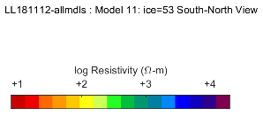
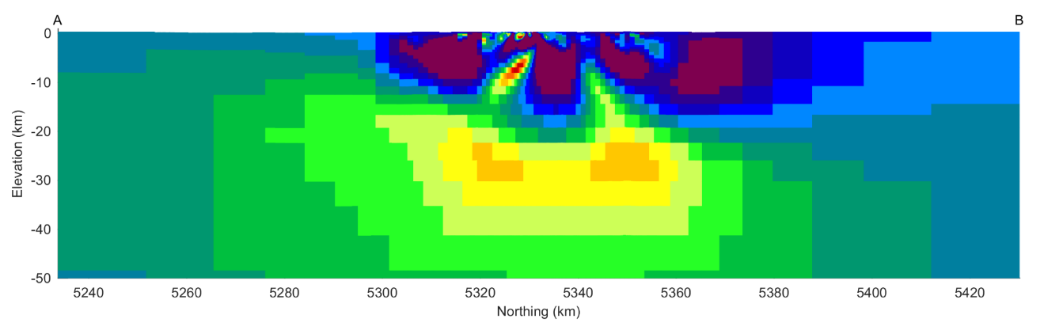
Larder Lake Magnetotelluric (MT) and Audiomagnetotelluric (AMT) section, 3D inversion
LNSZ
LLCDZ
N facing Skead Volc
Blake River volcanic rocks
Higher Conductivity ~17km depth
Graham Hill, Personal Com..
Notes:
MT and AMT on same section
Hotter colours are higher conductivity
Large block of higher conductive material at ~30km
Blow up central portion

Slide 35
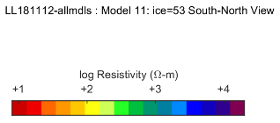
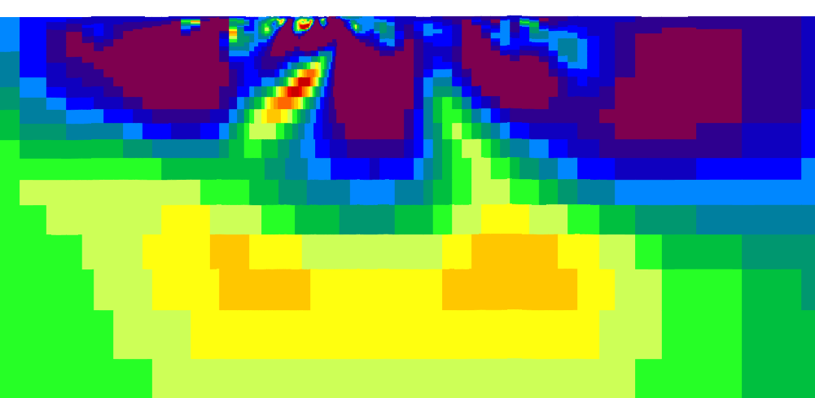
Larder Lake MT – AMT section, 3D inversion
LNSZ
LLCDZ
N facing Skead Volc
Blake River volcanic rocks
LLCDZ has conductivity contrast traced to +30km
LNSZ exhibits very minor conductivity contrast to under 3km
Contrast typically considered alteration effect
?
Graham Hill, Personal Com..
Notes:
C-LL break has a conductive finger from the conductive lower zone
LN- has little zone of conductivty

Slide 36
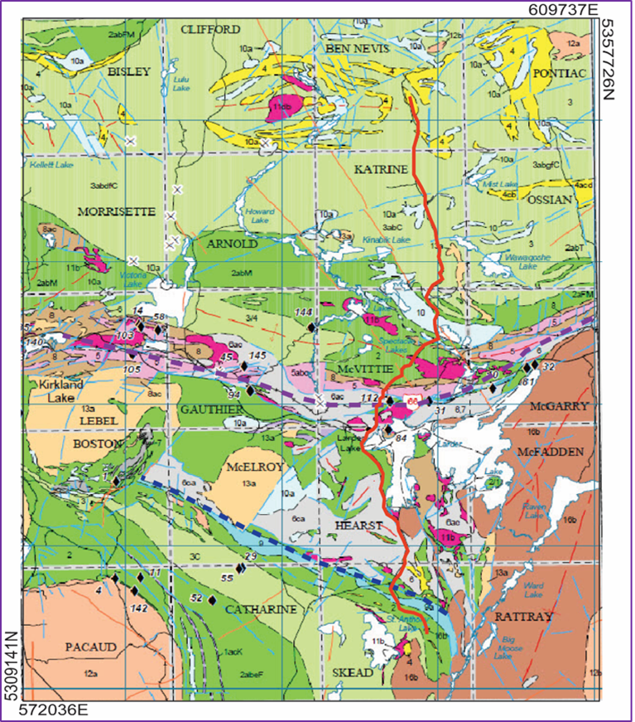
Mulven / Misema-Mist Lake fault targeted from recent geophysical data in the Blake River Group
LNSZ
LLCDZ
MLF / MMF
MMF
MLF
(Modified after, Roots et al. 2019)
Notes:
C-LL break has a conductive finger from the conductive lower zone
LN- has little zone of conductivty

Slide 37
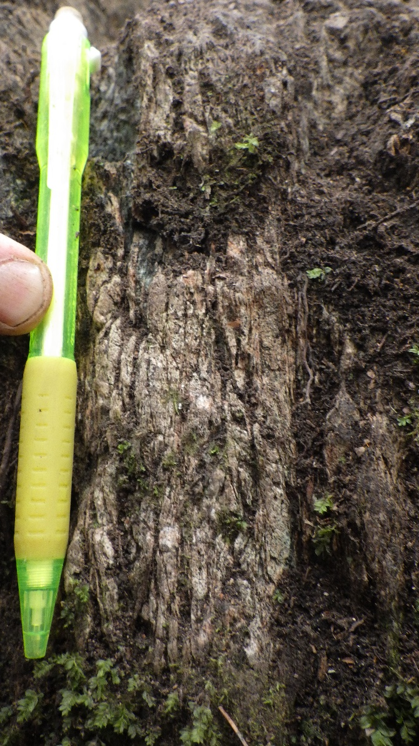
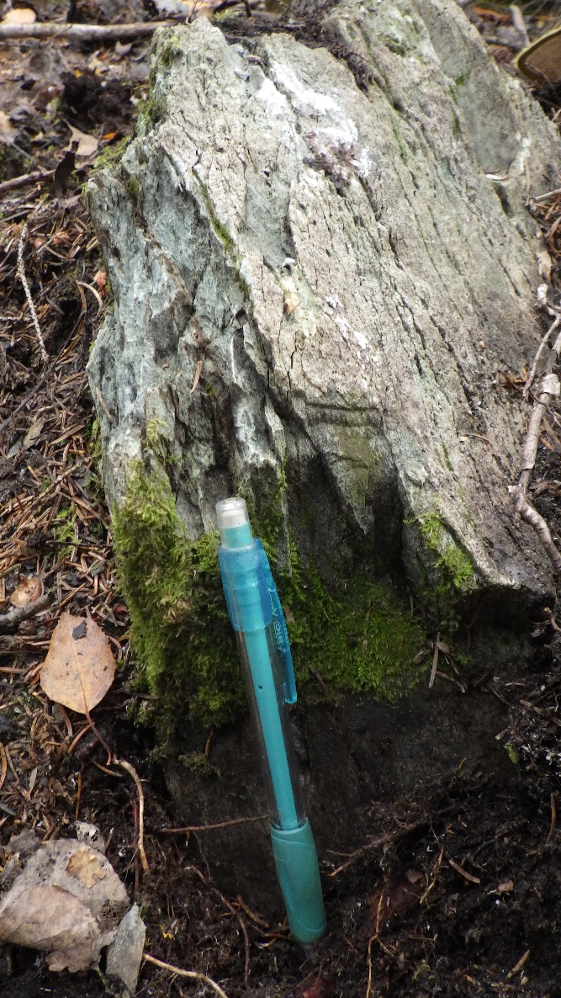
Field observations at the Mulven Fault
Fault zone foliation defined by alignment of chlorite, plagioclase, quartz veins and minor carbonate alteration.
MT anomaly possibly related to alteration associated with mineralized occurrences along the fault.
Notes:
Transect scale seismic line, southern half
Goes to north into Blake River and Ben Nevis,

Slide 38
Metal Earth – Seismic section
Lincoln Nipissing
Misema Lake-Mist Lake flt
The fertile, highly endowed faults manifest themselves geophysically as large through going features that separates domains that have distinct physical properties.
MT surveys shows a distinct contrast in the structural hanging wall of the fertile systems.
CLLF
Notes:
Transect scale seismic line, southern half
Goes to north into Blake River and Ben Nevis,

Slide 39
Geophysical expression of the faults
LLCDZ widespread alkalic volcanic rocks intercalated with Timiskaming sedimentary rocks and a wide damage zone is observed in the footwall. Fault extends to + 30km, into lower crust / mantle and is associated with strong carbonate alteration, potassic alteration and large gold deposits (11Moz Kerr Addison)
LNSZ depth extent- approx. 12km associated with similar alteration to main LLCDZ and associated with numerous gold prospects and similar alteration.
MLF / MMF - extension to >21km. Minimal carbonate alteration, quartz veins, localized mineralized occurrences, and lack of extensive alkaline intrusions

Slide 40
Part 6: Conclusions – and metallogenic implications
Recent work to unravel the early character of the LLCDZ suggests a significant tectonic event pre-Timiskaming sedimentation.
  An unconformity on the northern contact of the Timiskaming with the Larder Lake Group, suggests early uplift and erosion of the volcanic rocks of the Larder lake Group.
  This contact may represent a folded unconformable contact with the Blake River Group.
  This new model suggests the LLCDZ did not originate as a lithospheric scale crustal fault as postulated by Cameron, Bleeker or Bédeaux, but it formed as a primary stratigraphic contact that was later reactivated.

Slide 41
Conclusions – and metallogenic implications
Previous models do not consider the stratigraphic nature of this fault :-
  Cameron and Bleeker interpreted that the LLCDZ originated as a crustal scale extensional fault, forming during crustal scale extension as a result of lithospheric thinning during Timiskaming alkaline magmatism.
  Bédeaux interprets the fault as a reverse fault which formed as a result of linkage of several segments during the terrane collision between the Pontiac and the Abitibi subprovinces, as an explanation for the present geometry of the fault.
  Wilkinson’s model interprets the fault as a late transcurrent fault system
Implications for mineralization based on the new model
  This primary contact acted as a plane of anisotropy, that localized the development of the fault and migration of hydrothermal fluids and gold mineralization.

Slide 42
Conclusions – and metallogenic implications
Geophysical surveys reflect this zone of significant alteration and mineralization.
  Geophysical techniques used to investigate the nature of the fault systems in the Larder Lake area – highlight limitations of the techniques.
  The strong conductive response and termination of horizontal seismic reflectivity is directly correlative with the major LLCDZ and highlights the significance of the structure – reflecting significant alteration and mineralization associated with the fault which extends to depth.
  The LLCDZ did not originate as a major terrane bounding fault, and compared to the LNSZ, they both form as basin bounding structures- demarcated by unconformities and juxtaposing older volcanic rocks against younger sedimentary rocks.

Slide 43
Thank you.
Stay up to date via the MERC Newsletter
Subscribe online by visiting:
Merc.laurentian.ca
Contact us with questions: merc@laurentian.ca
Connect with us on LinkedIn, Facebook, Twitter

