Slide 1
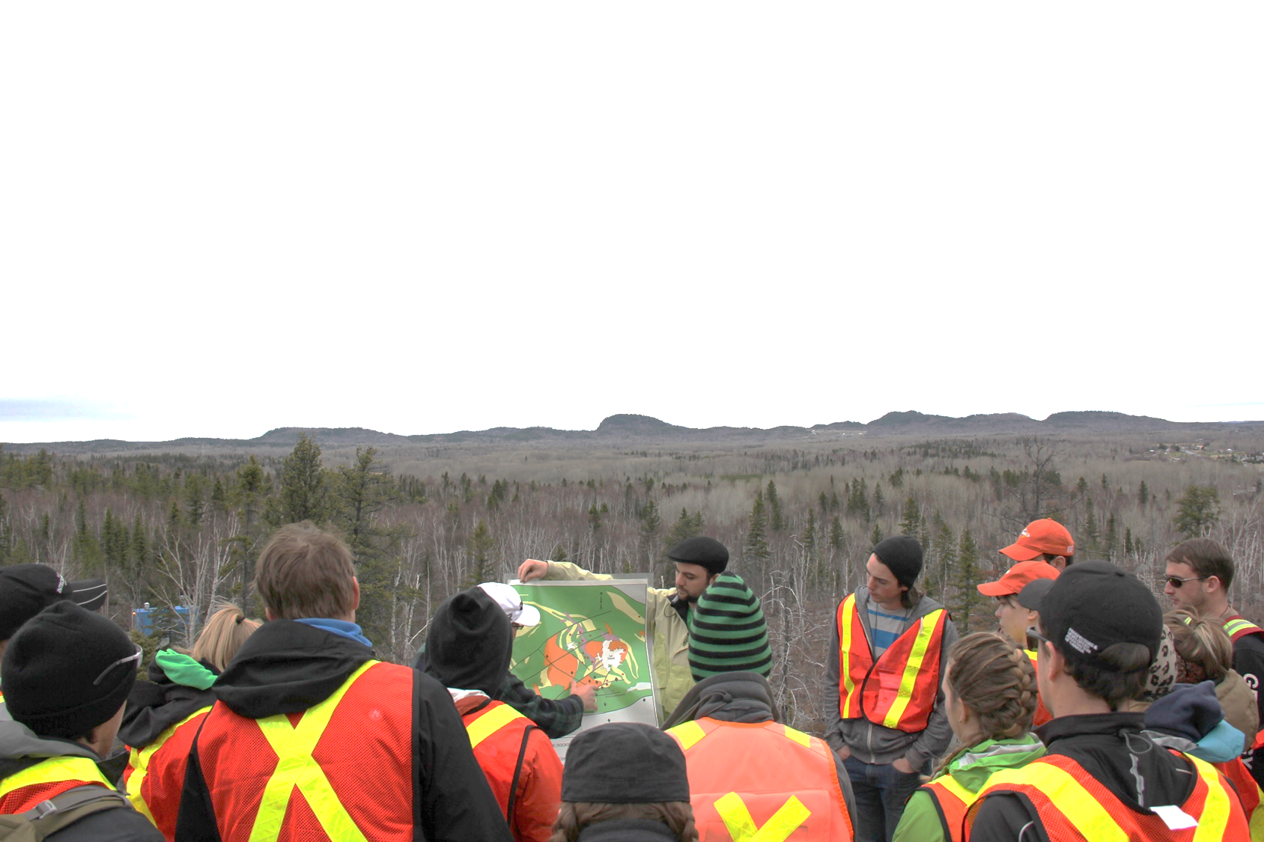
2020 PDAC Short Course: Greenstone belt architecture and metal endowment within the Abitibi Terrane
Crustal architecture and Volcanic Massive Sulfide (VMS) endowment from the Rouyn-Noranda transect
Taus R.C. Jørgensen
Research Associate, Metal Earth
Mineral Exploration Research Centre
Harquail School of Earth Sciences
Laurentian University, Sudbury
tx_joergensen@laurentian.ca

Slide 2










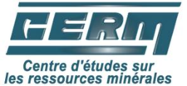
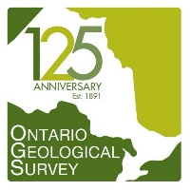










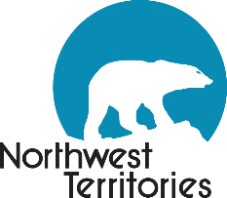

Partners

Slide 3
Outline
Metal Earth Rouyn-Noranda Transect Introduction
  Stratigraphy, deformation, and mineralization
Blake River Group
Noranda Camp: Geology and VMS deposits
Noranda Camp: Impact on the VMS genetic model, exploration criteria, and motivation for contributing new insights
Differential VMS endowment in the Archean
  Global Archean and Abitibi Greenstone Belt VMS distribution
Crustal architecture of the Metal Earth Rouyn-Noranda Transect and integration of geological and geophysical data
Proximity of VMS to transcrustal structures
Summary and conclusions

Slide 4
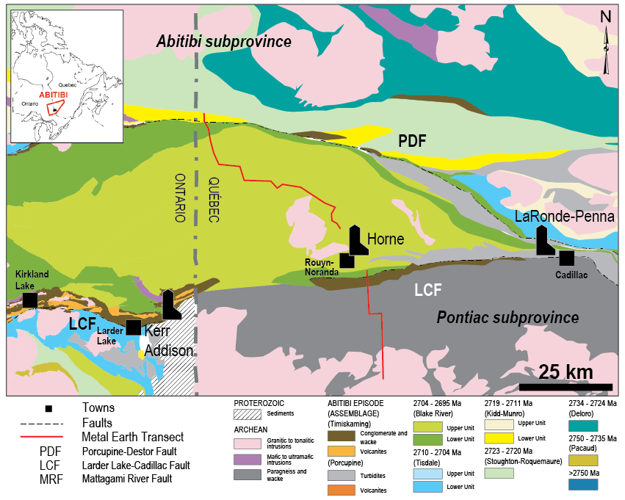
Metal Earth Noranda Transect
Collect geological data (lithological, structural, geochemical, geochronological, mineralization, alteration, compile previous work)
Integrate newly acquired geological and geophysical data (seismic, MT, gravity) with historical data, to produce a crust to mantle cross-section through the transect
Compare the Rouyn-Noranda cross-section to other transects to establish differences between endowed and less-endowed greenstone belts
Thurston et al. (2008) – Economic Geology, v. 103, p. 1097-1134

Slide 5
Transect overview: Stratigraphy
Abitibi subprovince
Kinojevis Group (ca. 2718-2722 Ma)
  Fe- and Mg-tholeiites, basalts, andesites, rhyolites, and komatiites
  Note the age overlap with Kidd-Munro and Stoughton-Roquemaure
Blake River Group (ca. 2704-2695 Ma)
  Tholeiitic, transitional, and calc-alkaline volcanic successions, several generations of plutons and mafic to intermediate dikes and sills
Timiskaming Group (ca. 2679-2669 Ma)
  Conglomerate and wacke
Pontiac subprovince
Pontiac Group (ca. 2682 Ma)
  Graywacke and minor mafic- to ultramafic volcanic rocks
Major crustal scale structures
Porcupine-Destor Fault
Cadillac-Lader Lake Deformation Zone (and Piché Structural Complex)
Thurston et al. (2008) – Economic Geology, v. 103, p. 1097-1134

Slide 6
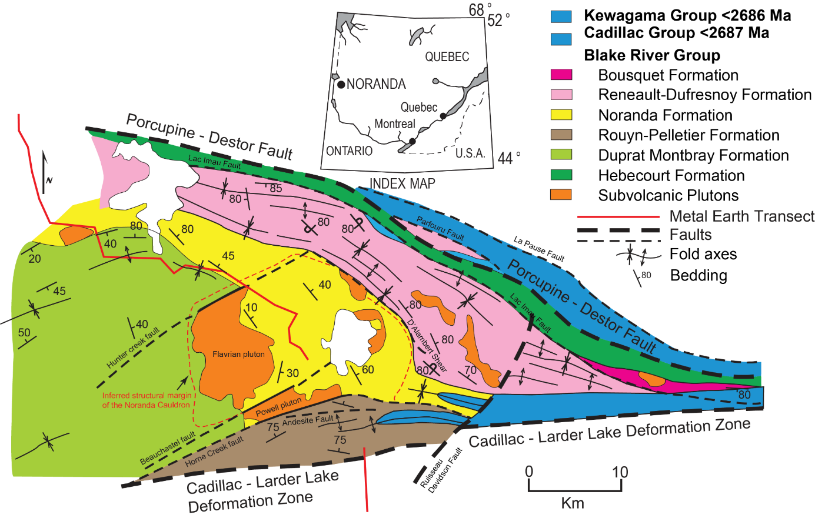
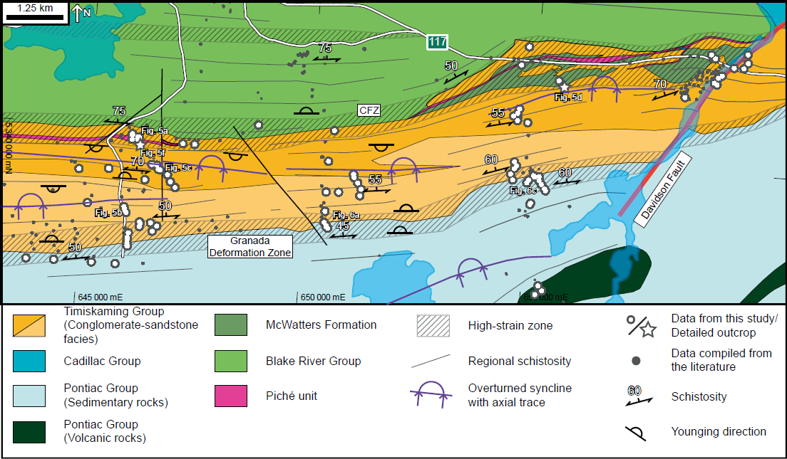
Transect overview: Deformation
Early shortening (>2680 Ma): pre-Timiskaming terrane accretion; tilting and folding of the BRG (e.g., Benn et al., 1994; Daigneault et al., 2002; Bleeker, 2012).
Extension (~2678-2672 Ma): Timiskaming deposition and syn-sedimentary magmatism (e.g., Davis, 2002; Pilote et al., 2014; De Souza et al., 2015). Possible initiation of the PDFZ and CLLFZ as normal faults (e.g., Bleeker, 2012).
N-S shortening (~2672-2665 Ma): Reactivation of the major breaks as thick-skinned thrusts; CLLFZ nucleation by linking of early structures during thrusting (Bleeker, 2012; Bedeaux et al., 2017).
Extension (local?): Reactivation of the major breaks as normal faults Mainly observed in the Rouyn-Noranda area. Uplift of the Pontiac (Daigneault et al., 2002; Bedeaux et al., 2017)
NW-SE shortening: Reactivation of the major breaks by final dextral transpression.
Modified from Gibson and Galley (2007); Bedeaux et al. (2017)

Slide 7
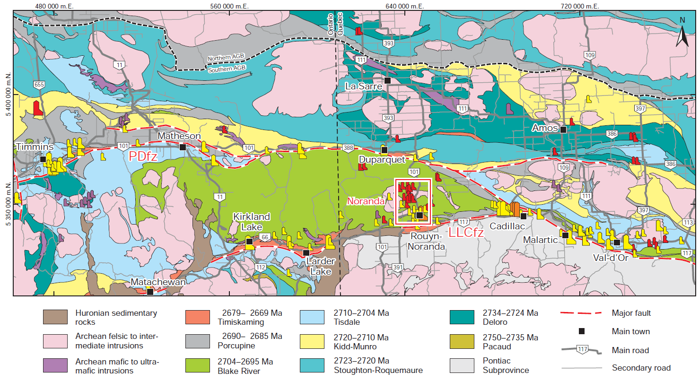
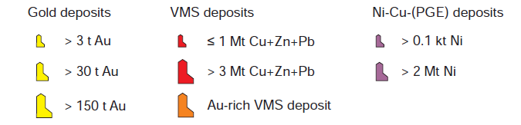

Transect overview: Mineralization
PDF: Only Au-showings near the transect
Noranda Camp:
20 VMS (in-ground metal endowment of 2.7 Mt Cu, 3.0 Mt Zn, 20.1 Moz Au, and ~146 Moz Ag)
19 orogenic Au deposits and several intrusion-hosted Cu-Mo deposits (e.g., Don-Rouyn and St. Jude)
CLLDZ: Au deposits
Astoria: 180,000 t grading 5.15 g/t Au and ~0.5 g/t Ag
McWatters: 333,750 t grading 11.07 g/t Au and 1.44 g/t Ag
Monecke et al. (2017) – Reviews in Economic Geology, v. 19, p. 169-223

Slide 8
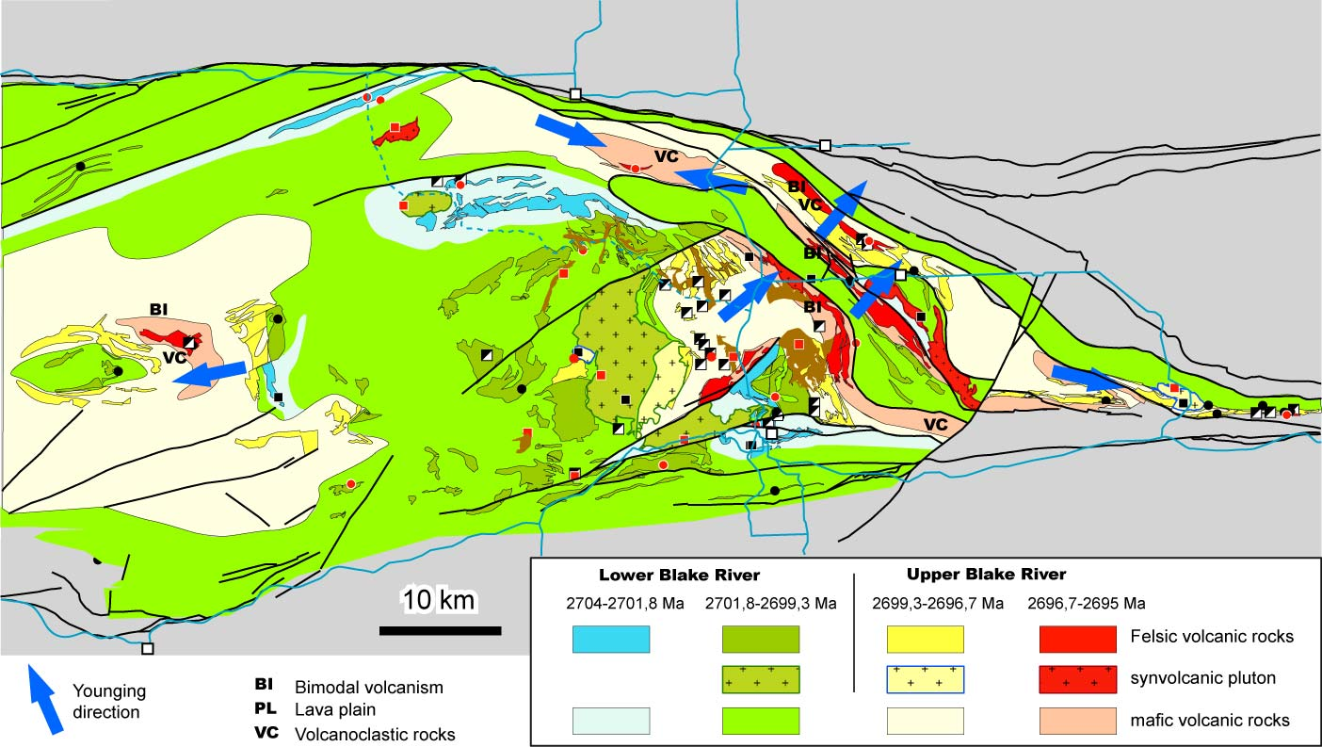
Blake River Group
Noranda District
Stages
Lower Blake River
  2704-2701 Ma
  2701-2699 Ma
Upper Blake River
  2699-2697 Ma
  2697-2695 Ma
Doyon-Bousquet-LaRonde District
Goutier et al. (in press); McNicoll et al. (2014) – Economic Geology, v. 109, p. 27-59

Slide 9
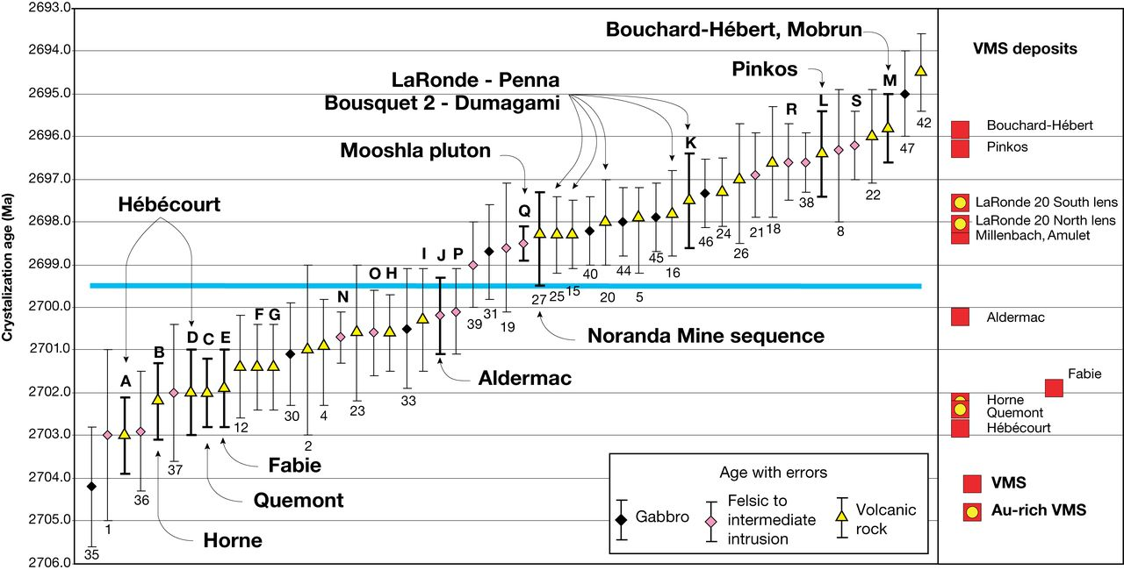
Blake River Group
Two Au events:
2704-2701 Ma
  Horne
  Quemont
2699-2697 Ma
  LaRonde 20 South lens
  LaRonde 20 North lens
McNicoll et al. (2014) – Economic Geology, v. 109, p. 27-59

Slide 10
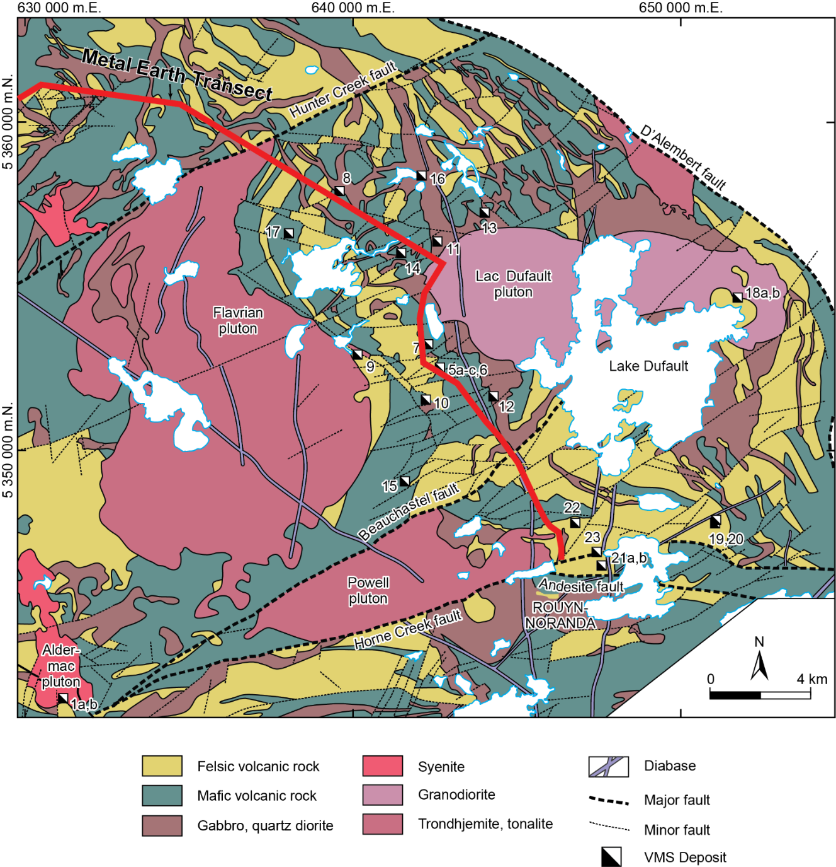
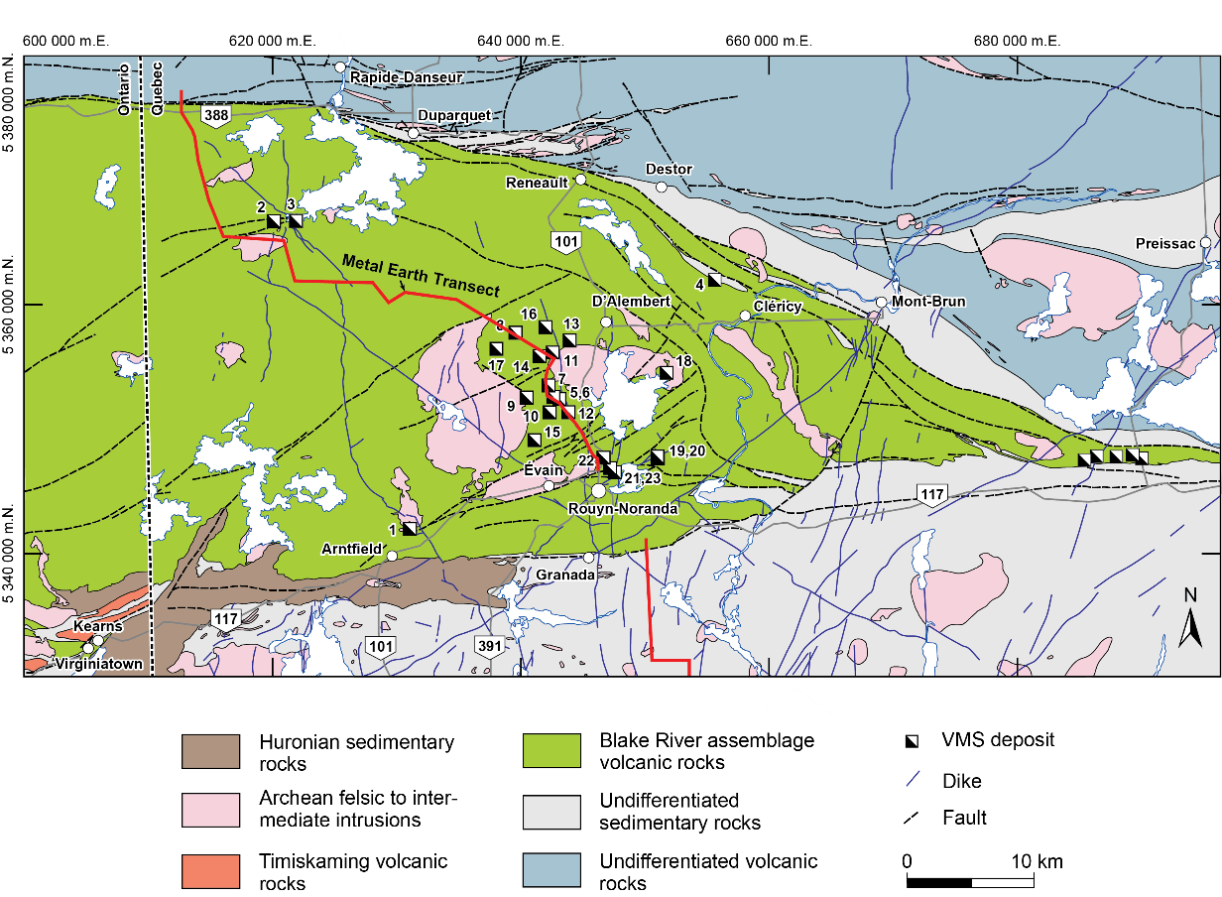
Noranda Camp Geology
Monecke et al. (2017) – Reviews in Economic Geology, v. 19, p. 7-49 (modified from Système d’information géominière du Québec)

Slide 11
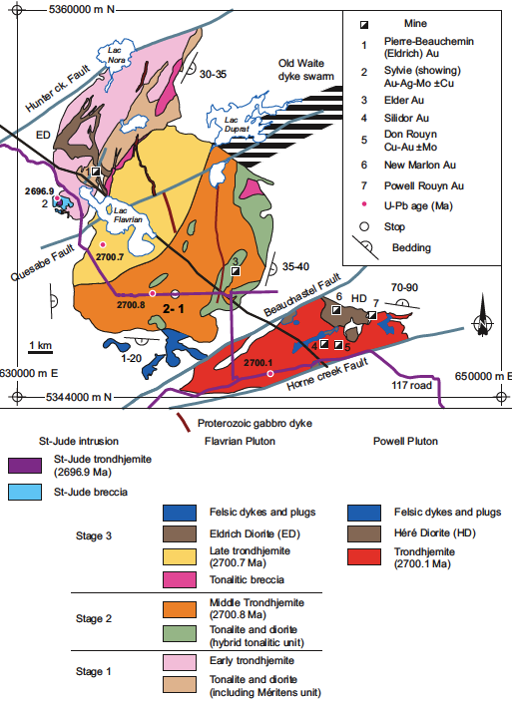
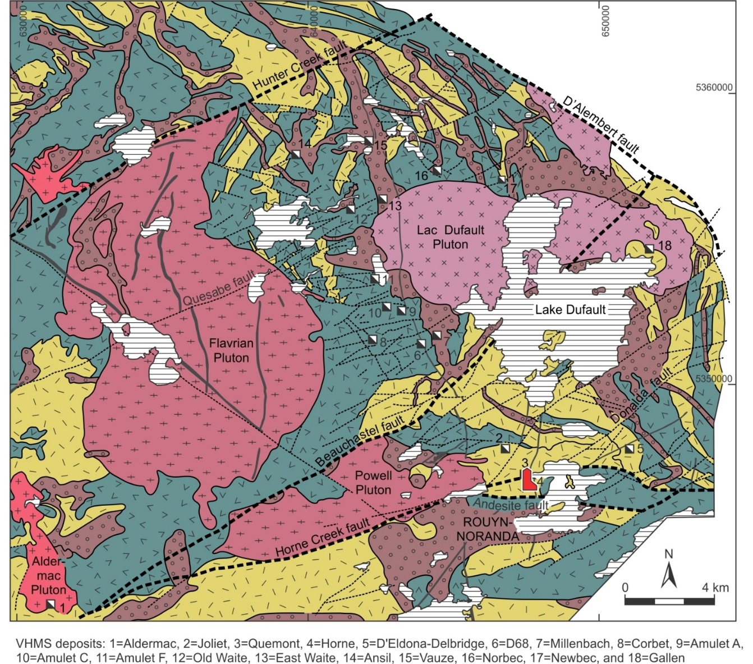
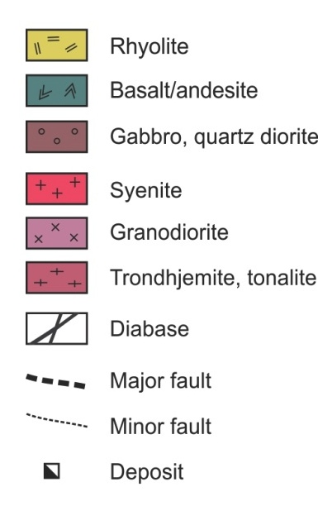
Flavrian and Powell Synvolcanic Intrusions
Noranda Camp Geology
Low Al TTG
Tonalite-Trondhjemite Diorite
Lode Au deposits
St. Jude Bx
Cu, Mo, Au
Don-Rouyn
Cu, Mo, Au, W
Monecke et al. (2017) – Reviews in Economic Geology, v. 19, p. 7-49 (modified from Système d’information géominière du Québec); Mercier-Langevin et al. (2011)

Slide 12
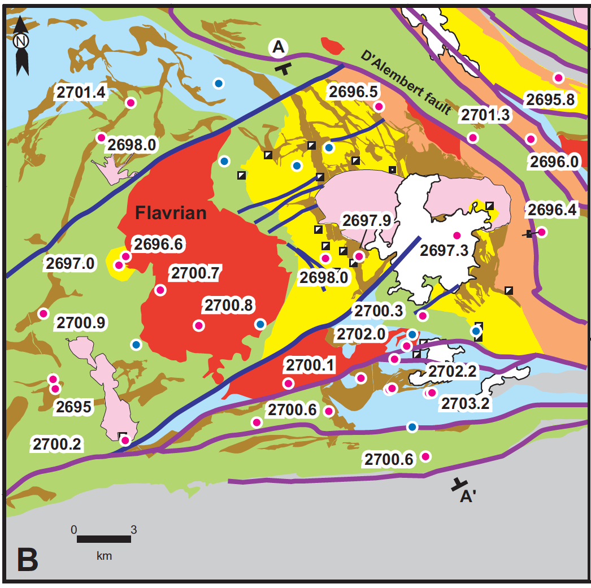
Noranda Camp Geology
Stages: 2704-2701, 2701-2699, 2699-2697, 2697-2695 Ma
Monecke et al. (2017) – Reviews in Economic Geology, v. 19, p. 7-49 (modified from Système d’information géominière du Québec); McNicoll et al. (2014)

Slide 13
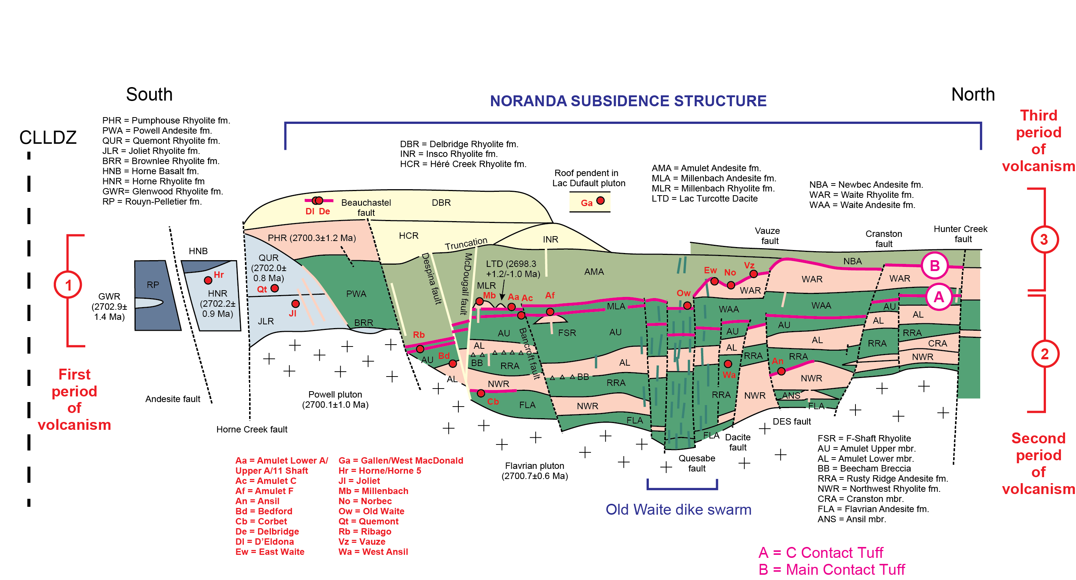
Noranda Camp Geology
Gibson (1990, 1993); modified by Monecke et al. (2017) – Reviews in Economic Geology, v. 19, p. 169-223

Slide 14
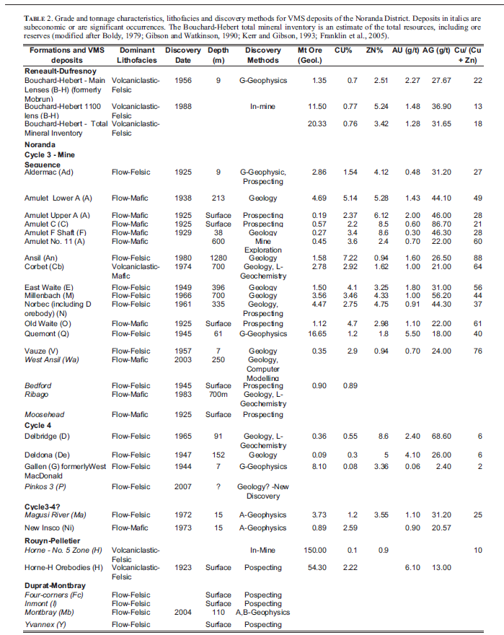
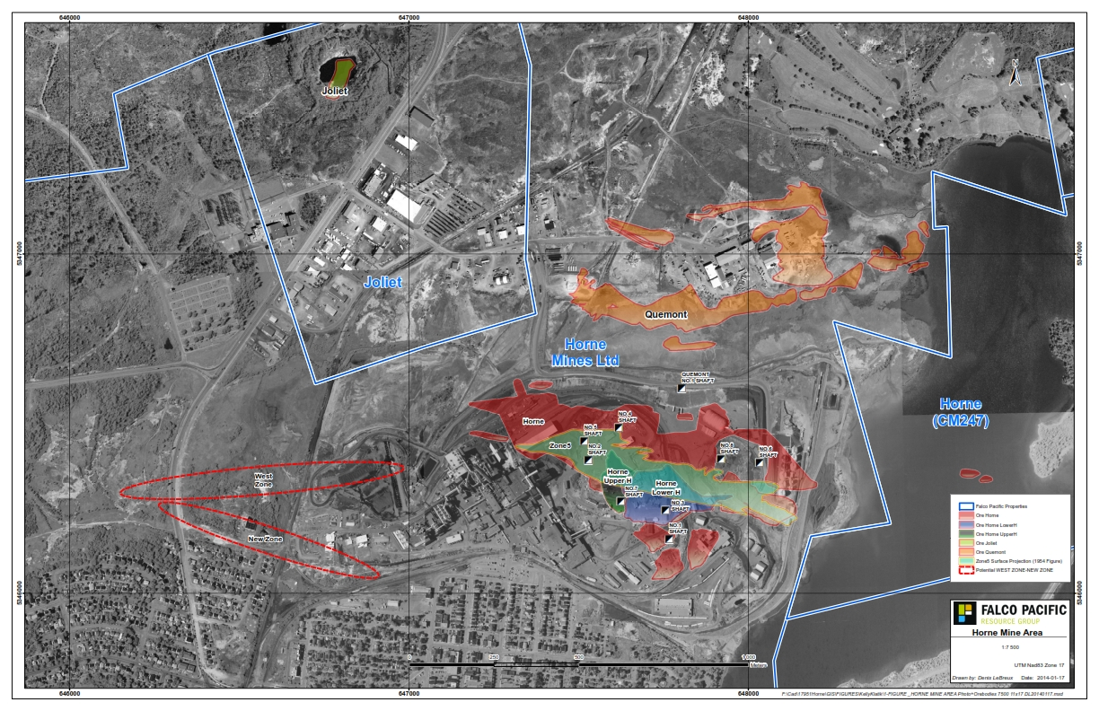
Noranda VMS
Au-Rich Horne and Quemont VMS deposits
Horne: 53.7 Mt, 2.2%Cu, 0.17% Zn,6.1 g/t Au, 13 g/t Ag (1927-1989)
Quemont:13.83Mt, 1.32%Cu, 2.44% Zn, 5.59 g/t Au, 30.0g/t Ag
1.5 km diameter ~14 M oz Au
Mill & Smelter
Quemont
Horne West
Horne 5
Upper & Lower H
Galley and Gibson (2007) – Mineral Deposits of Canada, v. 5, p. 553-552; Falco Resources (2016)

Slide 15
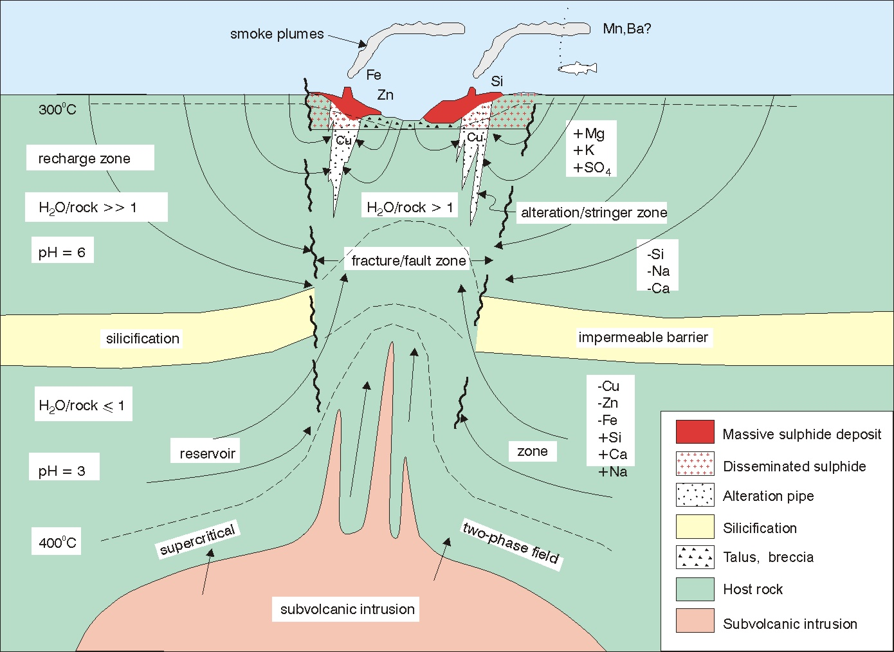
Influence on genetic model
The interplay of volcanism, sedimentation and, hydrothermal activity in space and time and the economic important of long-lived hydrothermal systems
The identification of volcanic settings and rhyolite petrochemical compositions that are favorable for VMS deposits
Importance of synvolcanic structures in controlling the formation and preservation of VMS deposits
The nature of sub-seafloor sulfide replacement processes and development of the zone-refining model
The exploration significance of extensive footwall silicification and high δ¹⁸O values
Hydrothermal Escape
Precipitation Site
Discharge Zone
Reservoir Cap
Reaction Zone
Heat Source
Galley (1993) – Journal of Geochemical Exploration, v. 48, p. 175-199; Franklin et al. (1995) – GSC Geology of Canada, no. 8, p 158-183

Slide 16
Influence on genetic model
Regional guides
Subvolcanic intrusions
Volcanological style
High temperature reaction zones
“Exhalite” zones
The exploration significance of extensive footwall silicification and high δ¹⁸O values
Local Guides
Alteration pipes
Ore zoning patterns
Hydrothermal Escape
Precipitation Site
Discharge Zone
Reservoir Cap
Reaction Zone
Heat Source
Galley (1993) – Journal of Geochemical Exploration, v. 48, p. 175-199; Franklin et al. (1995) – GSC Geology of Canada, no. 8, p 158-183

Slide 17
Impact on exploration criteria
Spilitized, bimodal, tholeiitic (komatiitic) volcanic successions containing proximal rhyolitic volcaniclastic and pyroclastic rocks. Key indicators of proximity include dome-cryptodome volcaniclastic complexes, large volumes of monolithological breccias, abundant dikes and sills and abrupt lateral facies changes.
Proximity to long-lived synvolcanic structures. Evidence of such structures includes: a) a high density of subvolcanic dikes and sills; b) major structural dislocations marked by unit truncations; c) abrupt lateral facies changes, and/or changes in strike/dip of primary layering; and d) post-mineral structures that could nevertheless represent reactivated synvolcanic faults. Synvolcanic structures commonly bound and control the location of subvolcanic intrusions and multiple dome-cryptodome complexes. Long-lived structures are necessary for the sustained hydrothermal fluid discharge that is key to the formation of giant VMS deposits.
An elongate, tectonically active, paleotopographic depression (e.g., graben) which can both focus hydrothermal activity and enhance the preservation potential of the resulting sulfide bodies.
Sulfide accumulation primarily by sub-seafloor cementation and replacement rather than exhalation.
Evidence of a long-lived hydrothermal system, including the stratigraphic stacking of VMS-style mineralization characterized by high base metal content.
Widespread silicification and/or quartz-sericite alteration characterized by high δ18O values, especially in combination with Zn enrichment. Early silicification can create a thermal and hydrologic cap rock that favors both thermal maturation and containment/focusing of ascending hydrothermal fluids.
Evidence of high heat flow, including the presence of a subvolcanic intrusion, FIII rhyolites, ultramafic flows and highly evolved and diverse mafic volcanic rocks.
Intercalated wackes, argillites, and/or carbonaceous argillites that overlie fragmental volcanic successions. Firstly, clastic or chemoclastic sedimentation is evidence of a hiatus in volcanic activity, and, secondly, an impermeable veneer of sediments can act as a thermal and hydrologic insulator, i.e., a cap rock, which can help to physically contain sulfide precipitation and to promote sub-seafloor replacement of footwall rocks and pre-existing sulfides. These sediments (particularly graphitic argillites) can be enriched in base and precious metals (especially Ag) in the vicinity of a VMS deposit.
Gibson et al. (2000) – Exploration Mining Geology, v. 9, p. 91-111

Slide 18
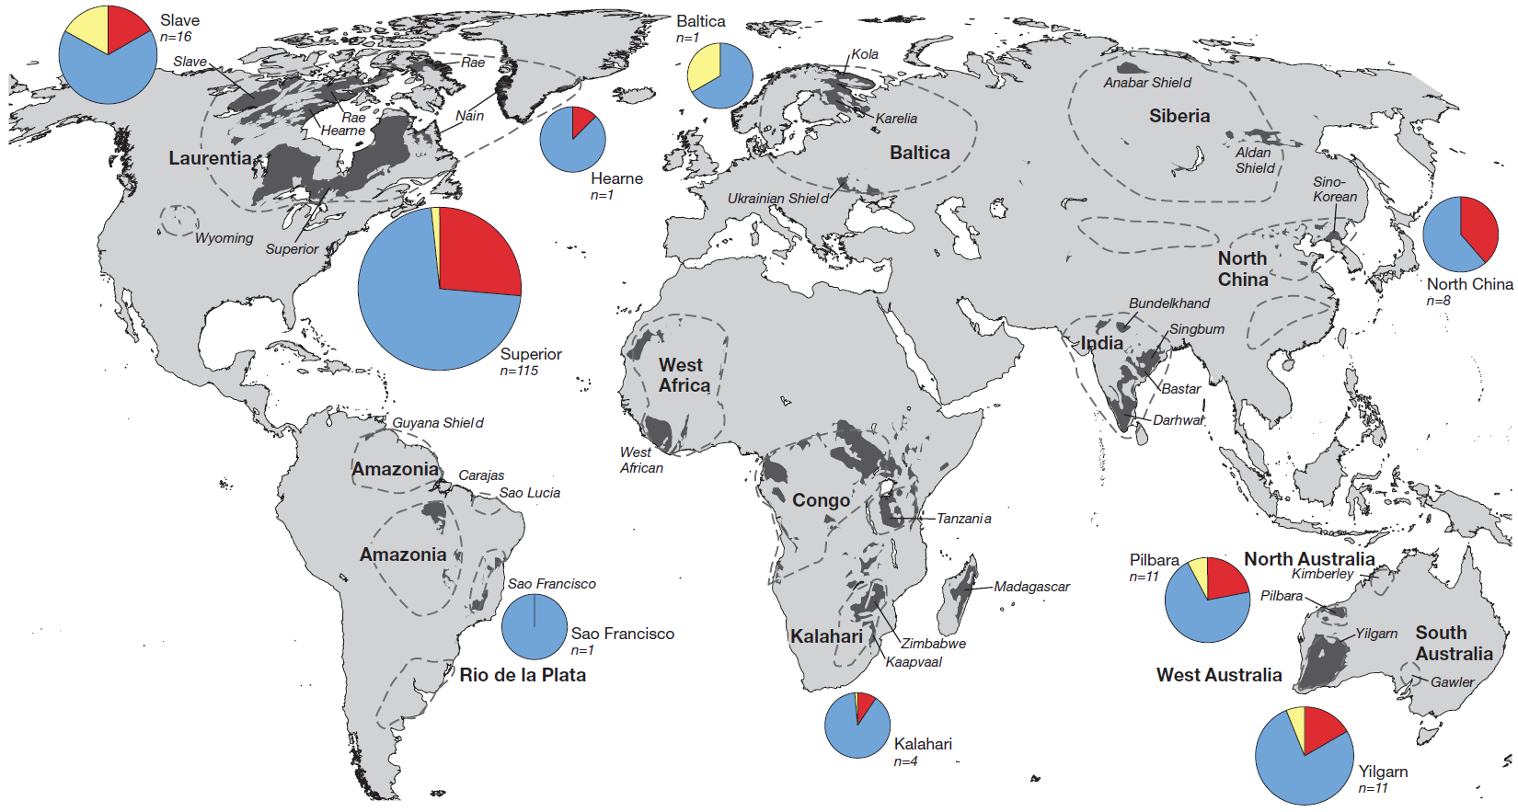
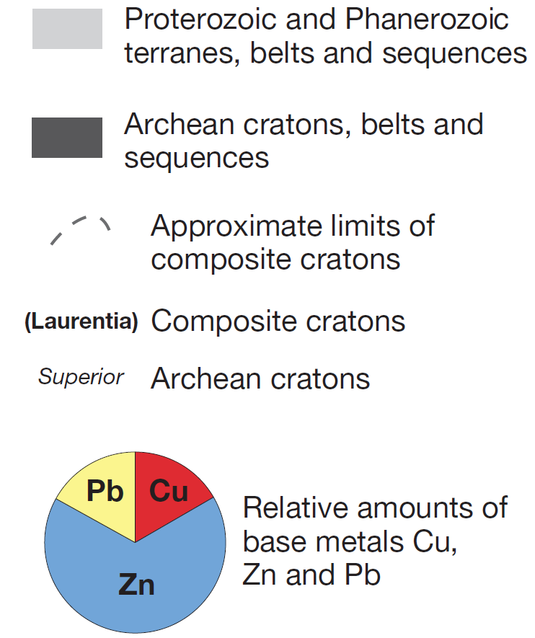
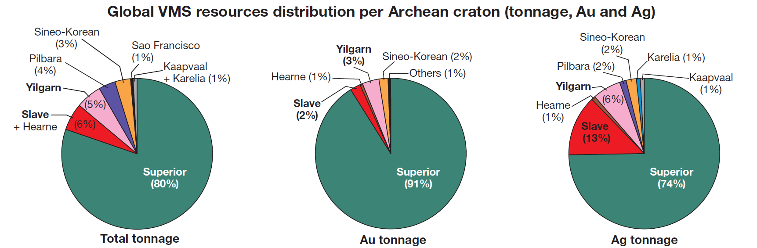
Global Archean VMS
Superior: n=115
Slave: n=16
Pilbara: n=4
Yilgarn: n=11
North China: n=8
Kalahari: n=4
Baltica: n=1
Hearne: n=1
Sao Francisco: n=1
Mercier-Langevin et al. (2014) – Economic Geology, v. 109, p. 1-9

Slide 19
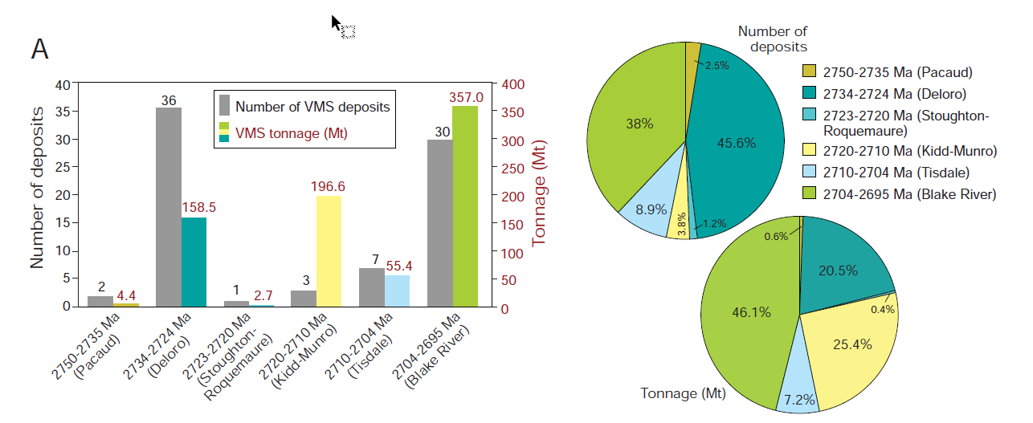
Volcanic episodes of the Abitibi greenstone belt
Monecke et al. (2017) – Reviews in Economic Geology, v. 19, p. 7-49

Slide 20
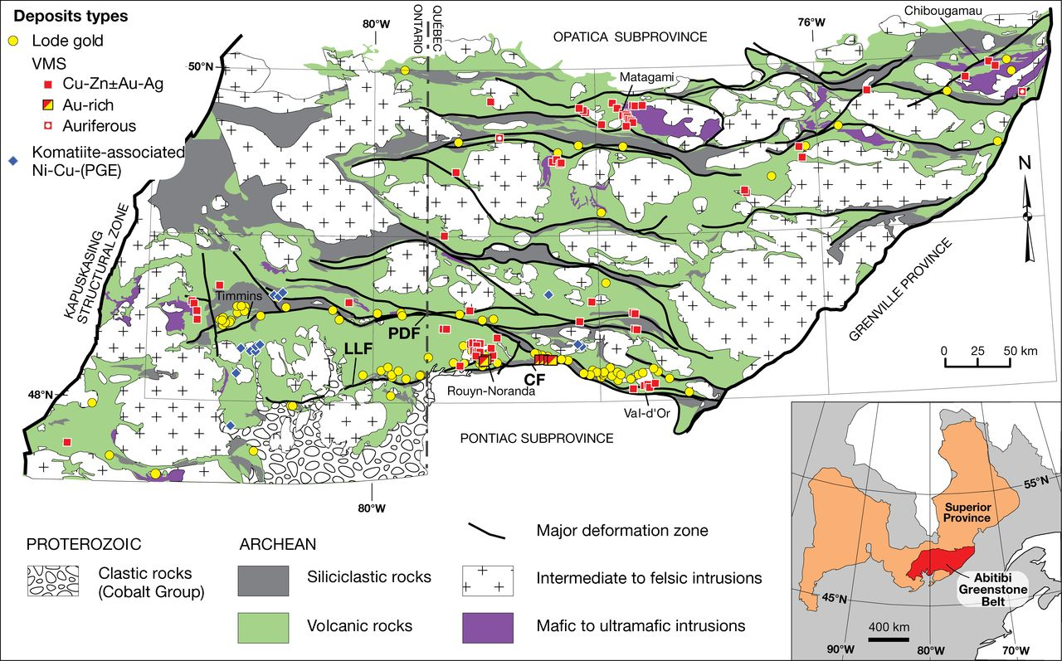
Abitibi greenstone belt VMS
~82 VMS Deposits in the AGB
Contained value of VMS deposits per km²
  Abitibi ~$1.24
  Wabigoon ~$0.13
Differential endowment within the Abitibi
Mercier-Langevin et al. (2014) – Economic Geology, v. 109, p. 1-9

Slide 21
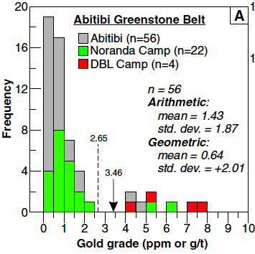
Abitibi greenstone belt VMS
~20 deposits in the Noranda Camp (~20% of known deposits in the Superior)
Au-rich deposits span 2740 Ma – 2697 Ma
Youngest Blake River episode (2702-2697 Ma) contains 92% of Abitibi VMS Au
Mercier-Langevin et al. (2011) – Mineralium Deposita, v. 46, p. 509-539

Slide 22
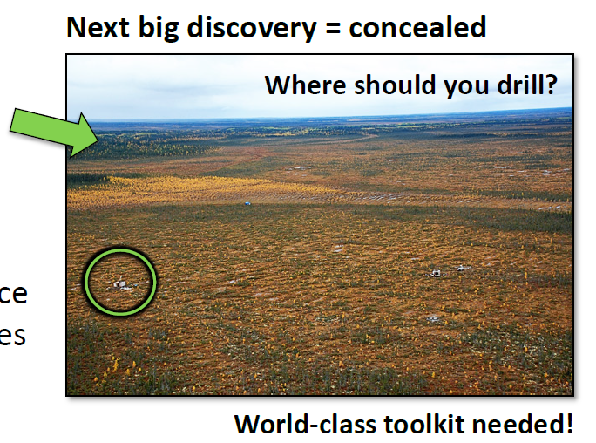
Motivation
Technical challenge
  78% of Canada concealed by lakes and surficial deposits
Benefits
  Fewer barren holes
  Reduced environment footprint
Dick Tosdal, CMIC 2017: https://cmic-ccim.org/events/national-mining-innovation-forum-2017-2/

Slide 23
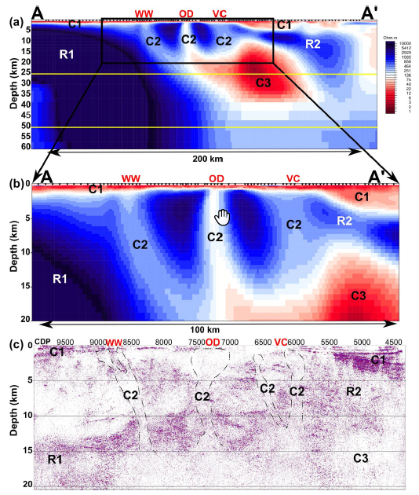
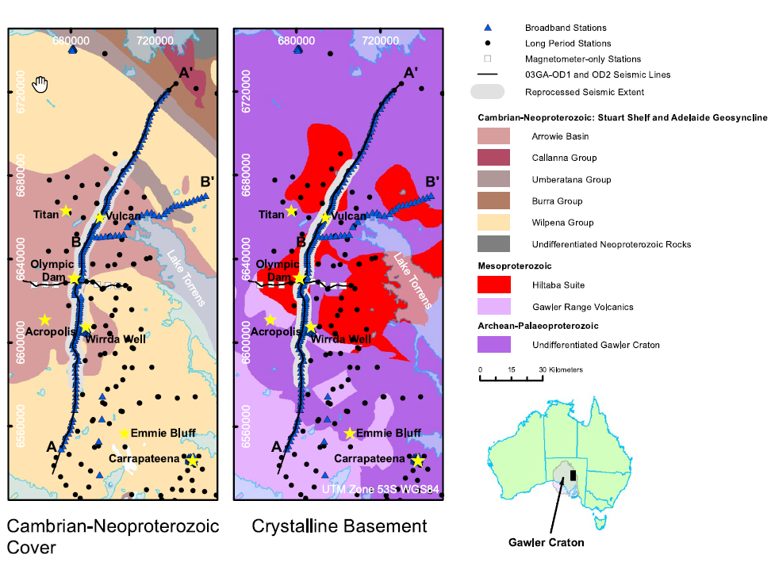
Motivation
Whole-of-crust imaging: Olympic Dam
Iron-oxide copper gold uranium (IOCG-U) district
Heinson et al. (2018) - Nature Scientific Reports 8:10608

Slide 24
Motivation
Focus on identifying whole-of-signatures that can help Greenfield-Brownfield VMS exploration
Belt and District Scale Criteria
  Felsic volcanic and subvolcanic centres
  VMS alteration
  Proximity to transcrustal structures
  Proximity to younger and linear sedimentary belts
Characterize a world-class VMS district
Craton Scale
Belt Scale
District Scale
Deposit
Scale

Slide 25
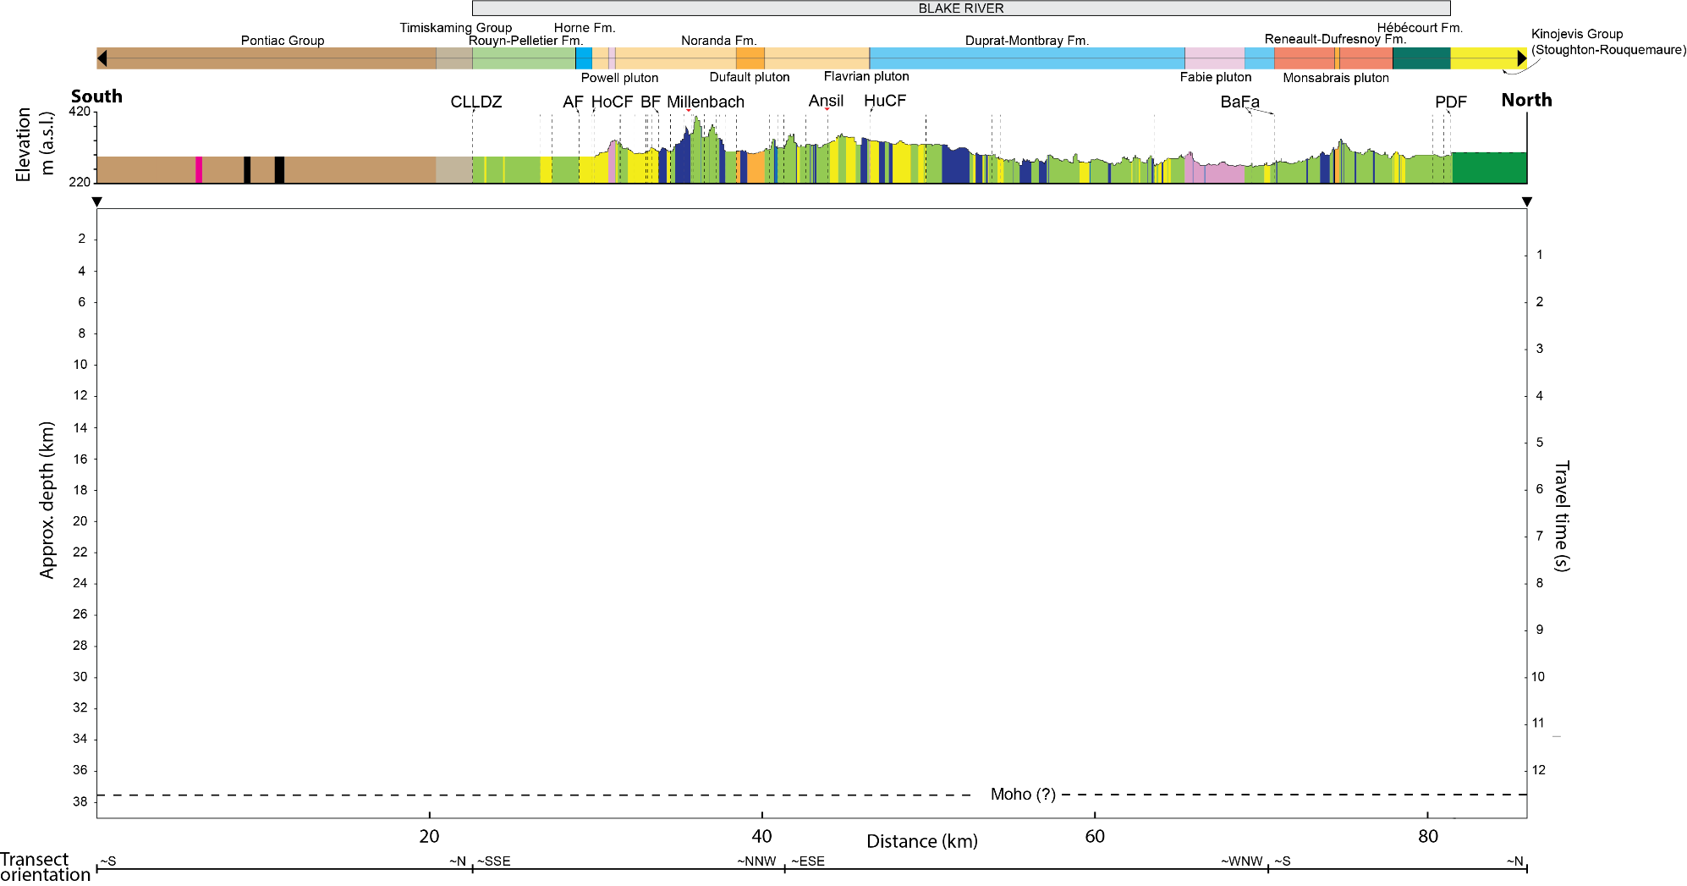
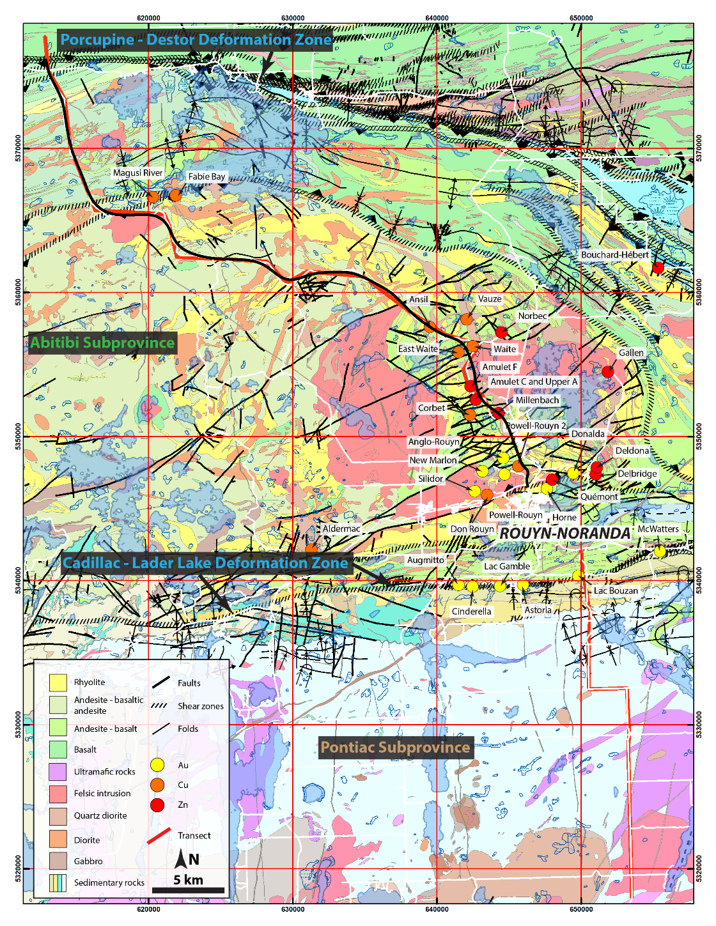
Noranda crustal architecture
Seismic data from ~Horne smelter to the PDF (black line)
Geology, MT, and Gravity data covers most of the transect (red line)
Modified after Système d'information géominière of Québec (2017)

Slide 26
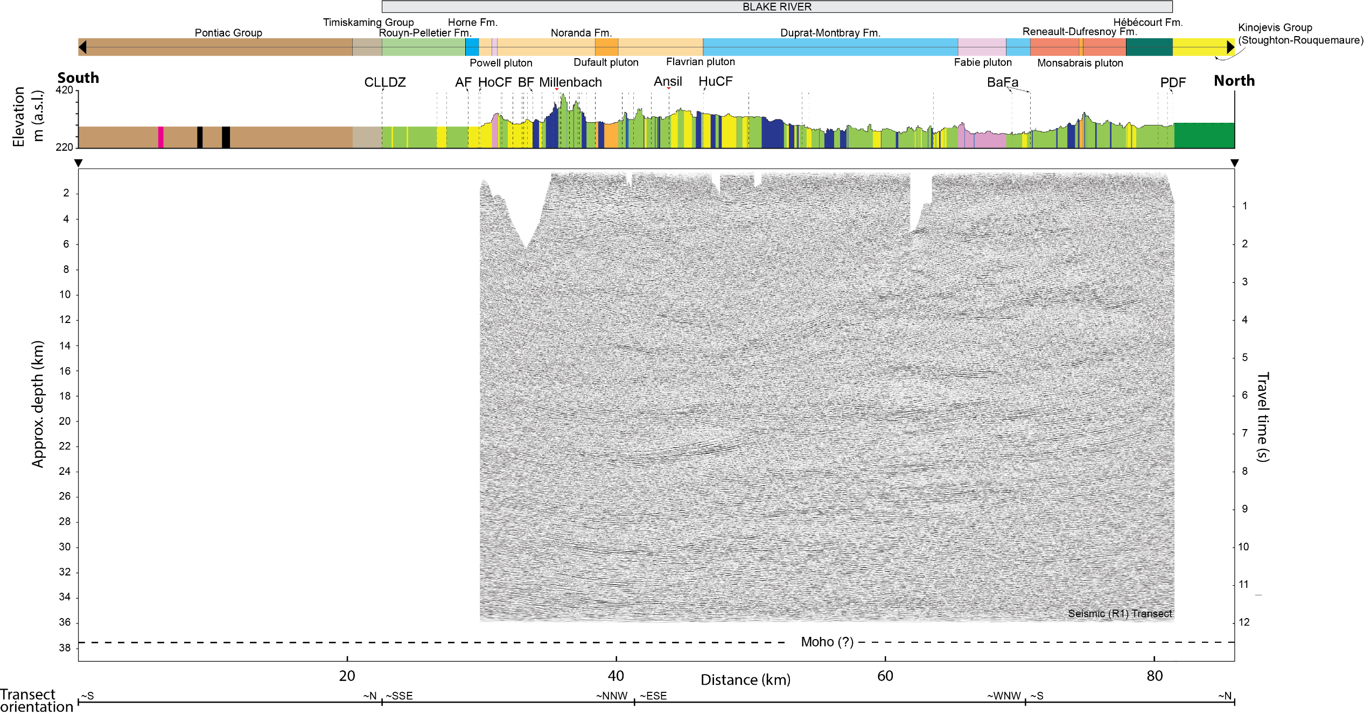
Noranda crustal architecture
Dominantly subhorizontal reflectors
Similar to Lithoprobe results but greater detail

Slide 27
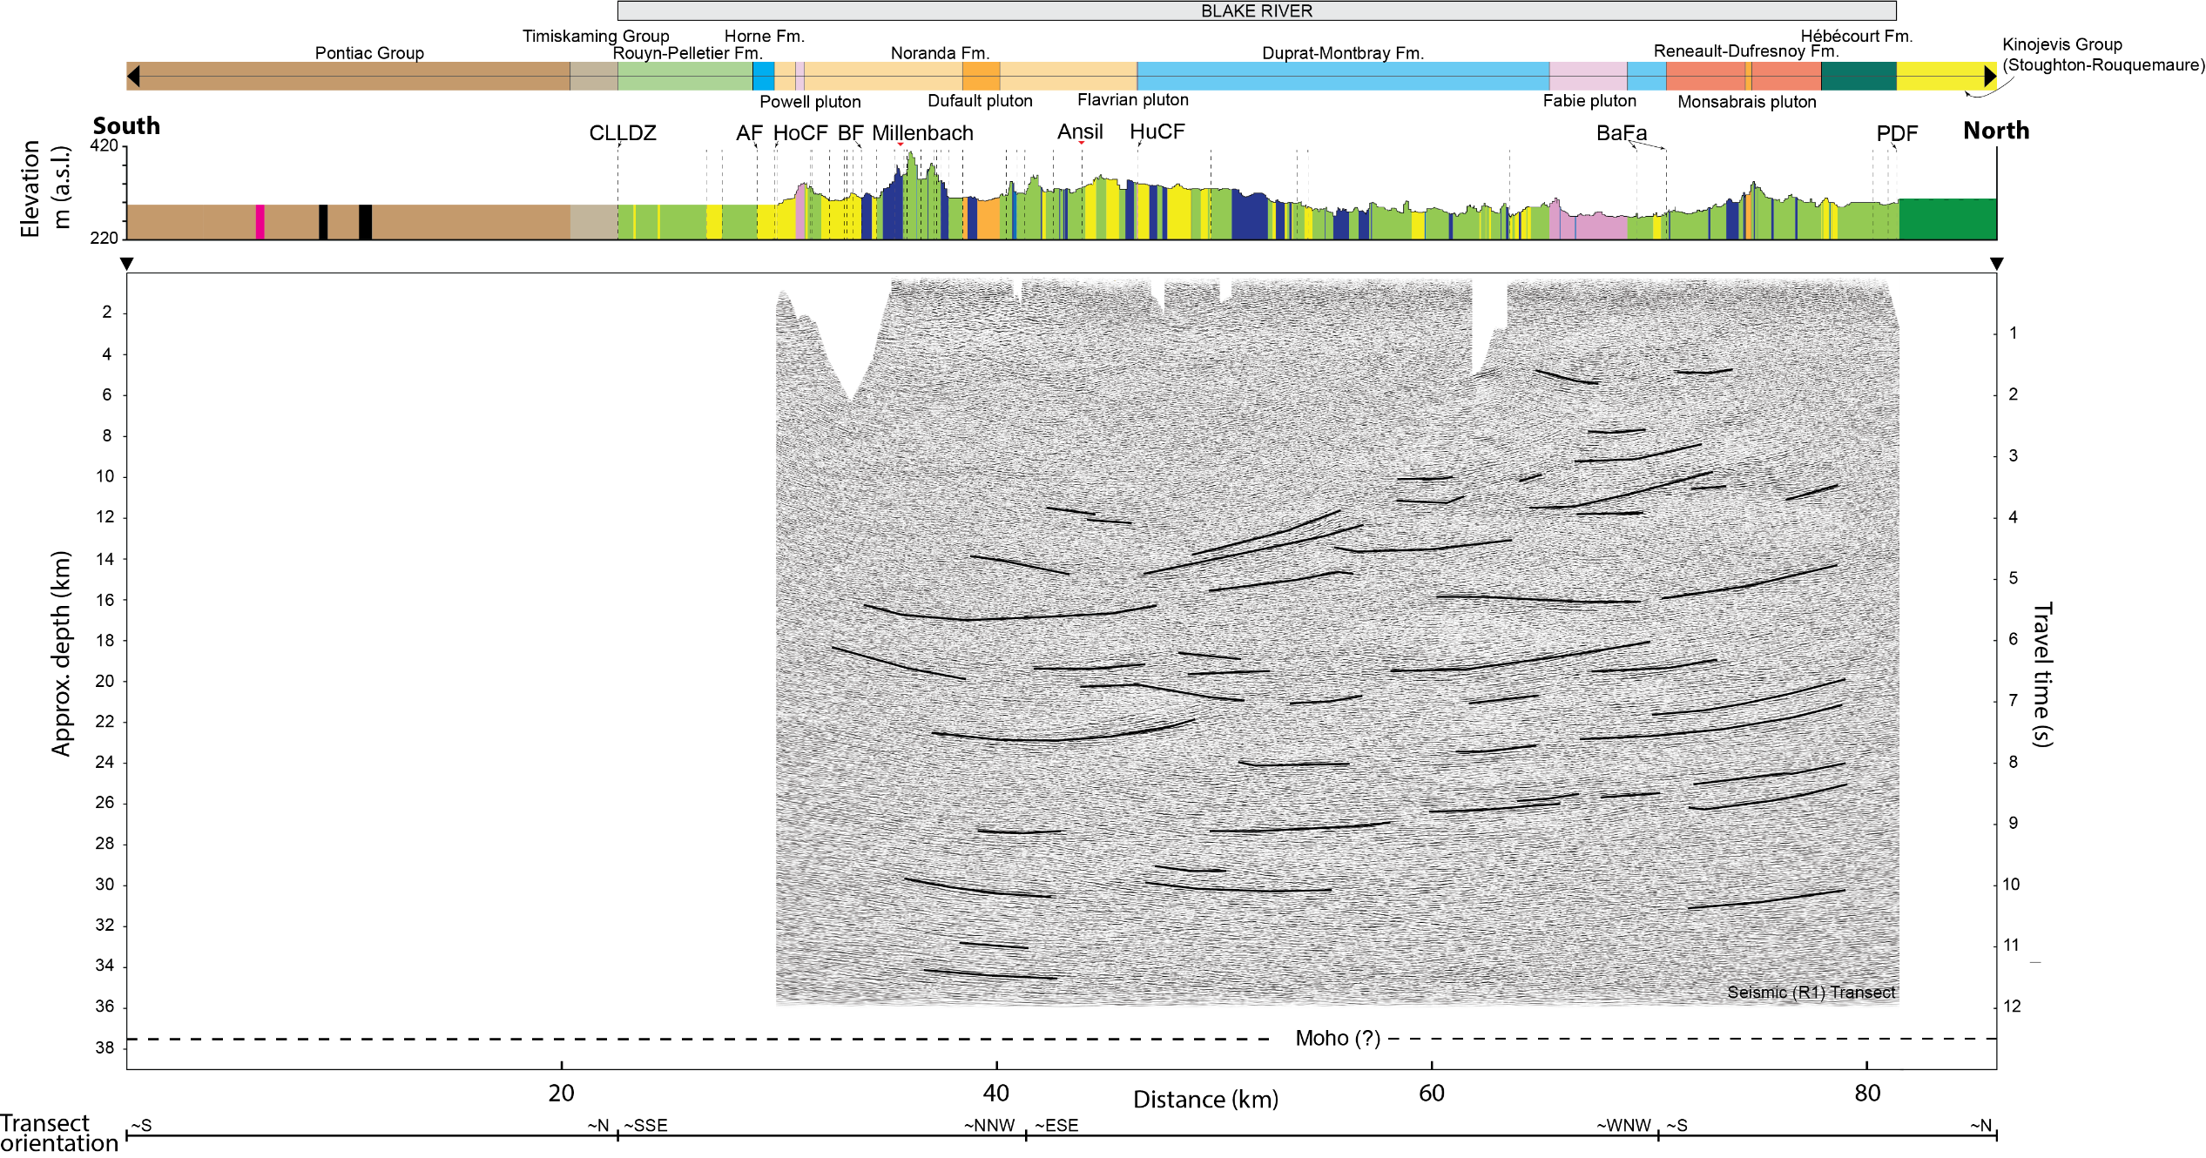
Noranda crustal architecture
Low seismic reflectivity from ~5-16 km
The low seismic reflectivity extends deeper in the south
Transition from greenstone to TTG gneiss

Slide 28
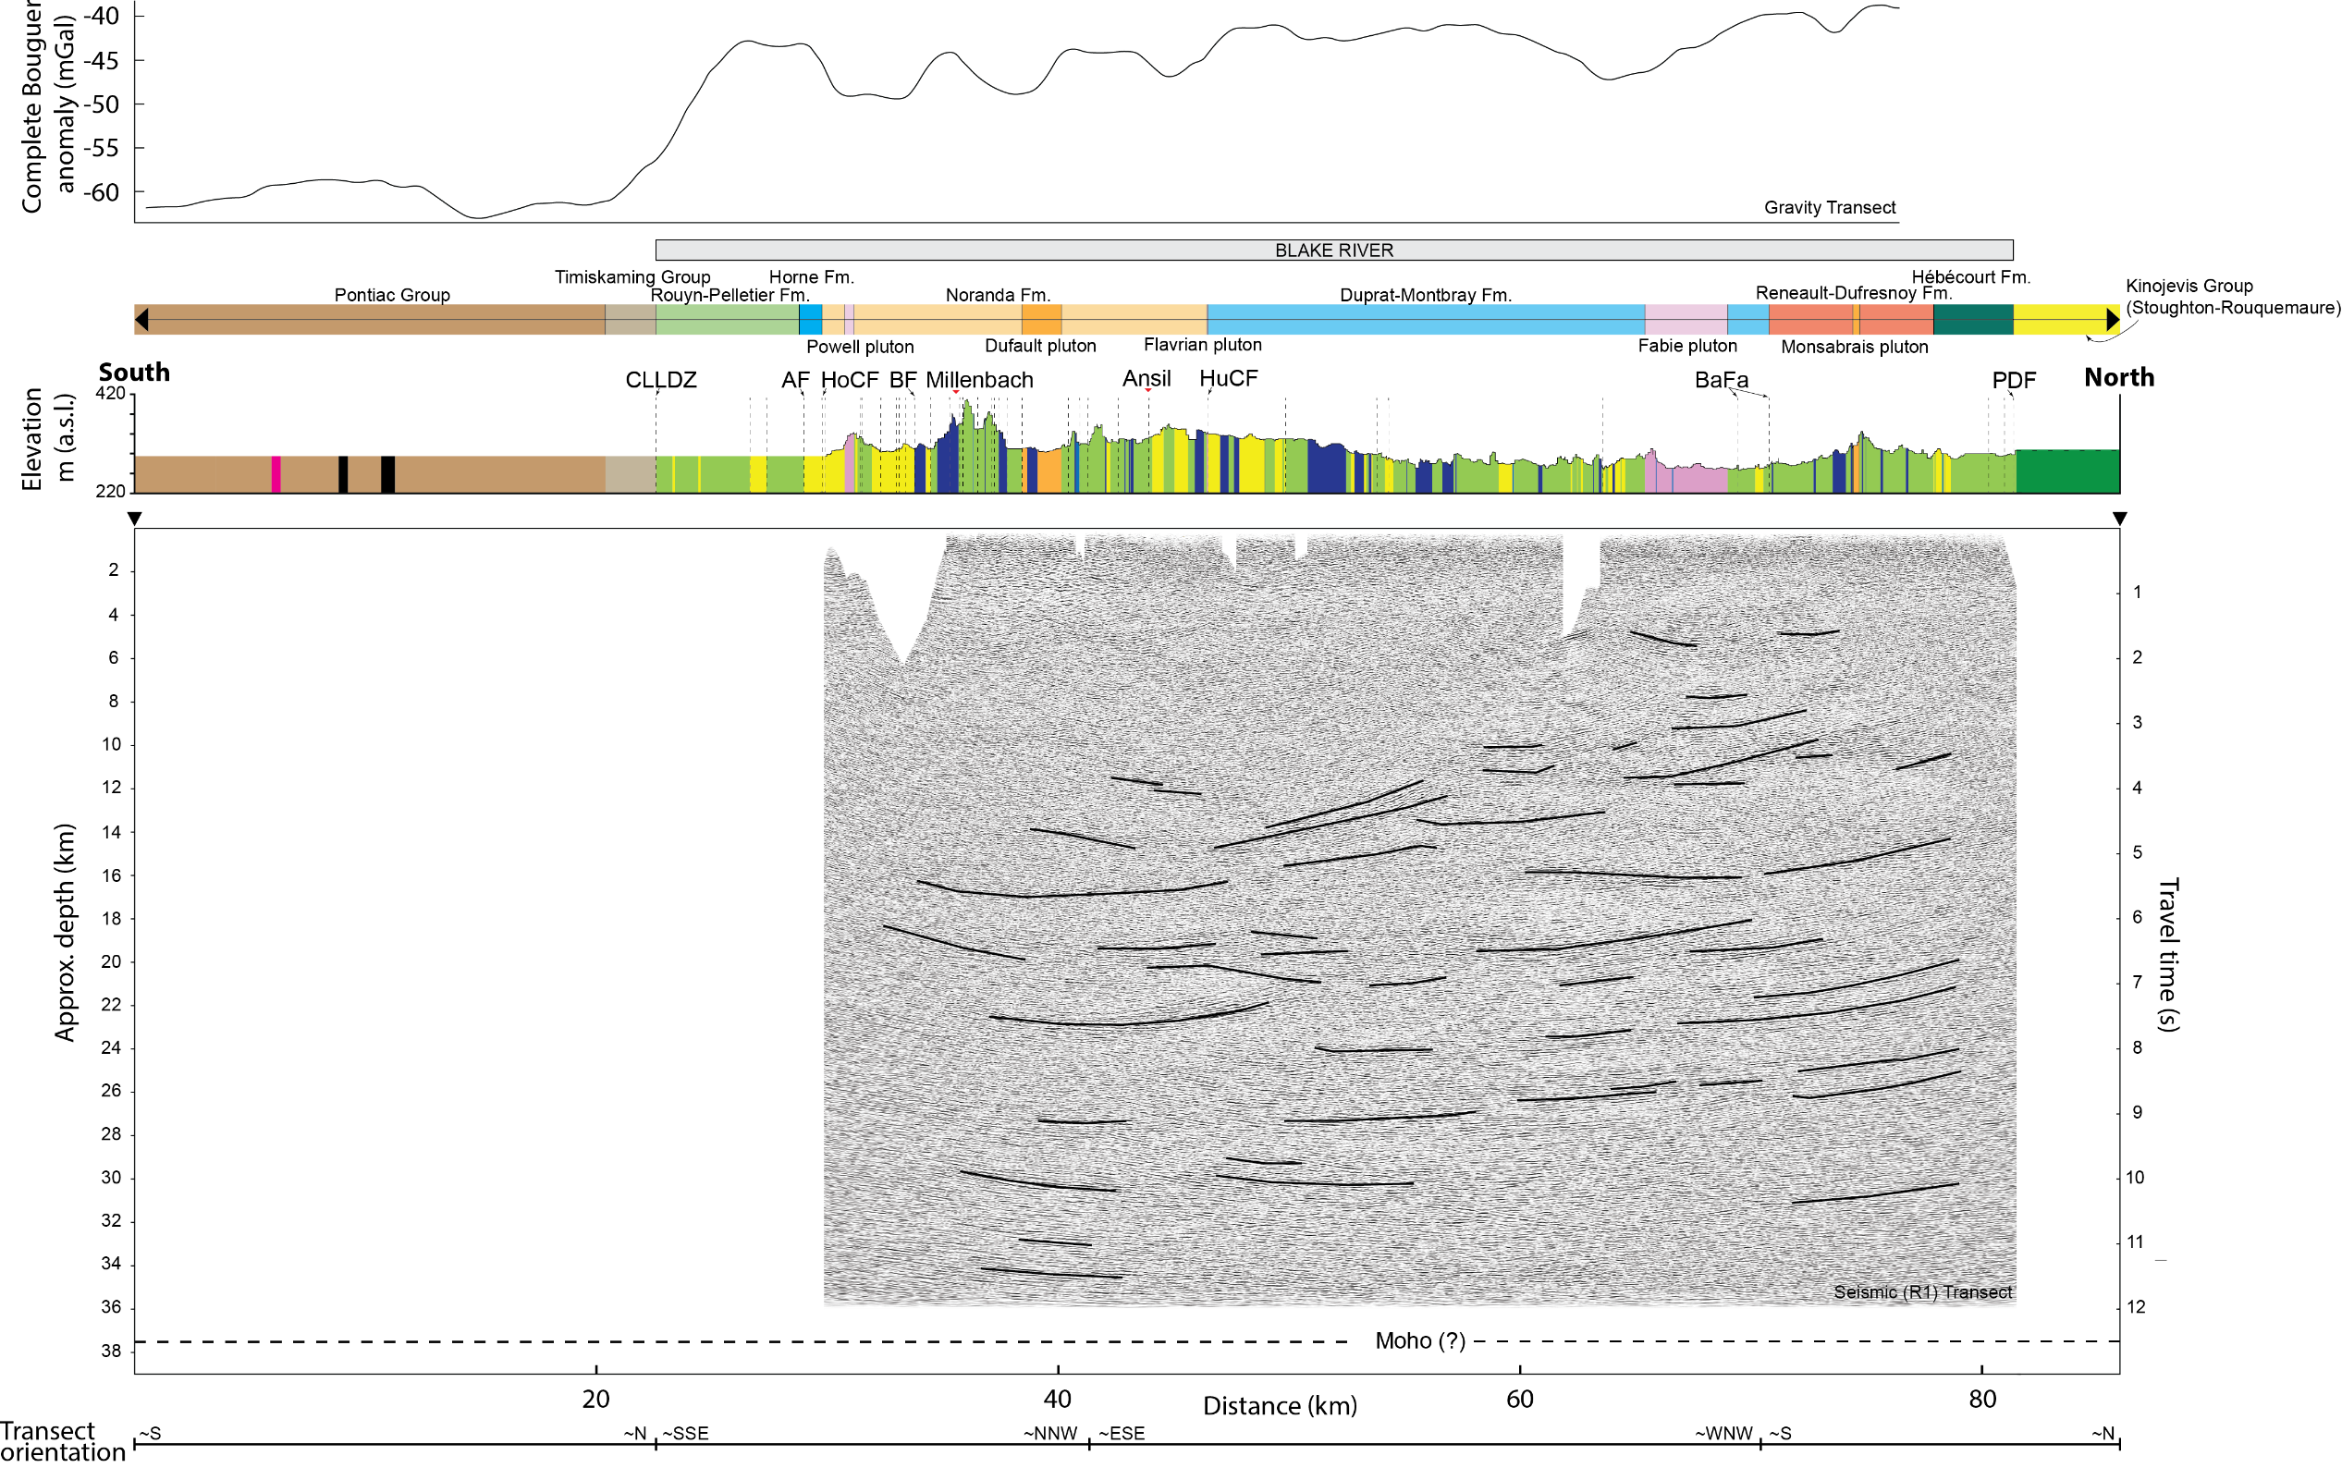
XYZ
Gravity profile clearly show the transition from Pontiac to Blake River
Smaller anomalies explained by felsic intrusions in the Blake River and ultramafic and mafic volcanic rocks in the Pontiac

Slide 29
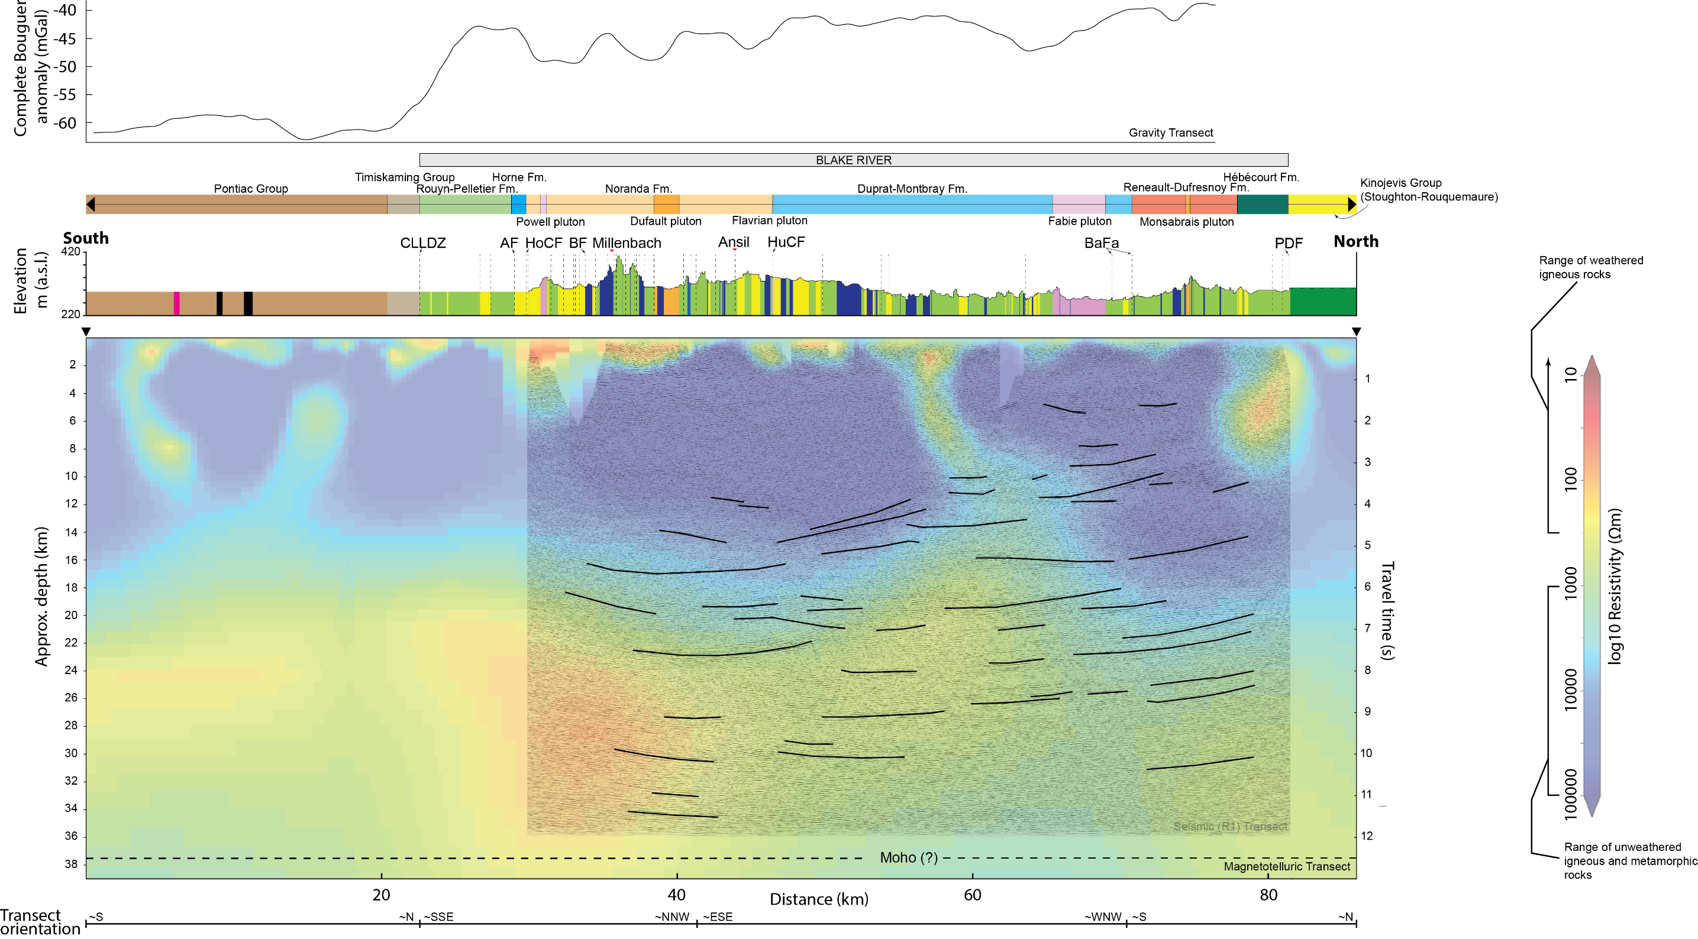
Several subvertical relatively low-resistivity zones but none match the CLLDZ
~10 km wide zone of relatively low-resistivity situated below the south end of the Blake River

Slide 30
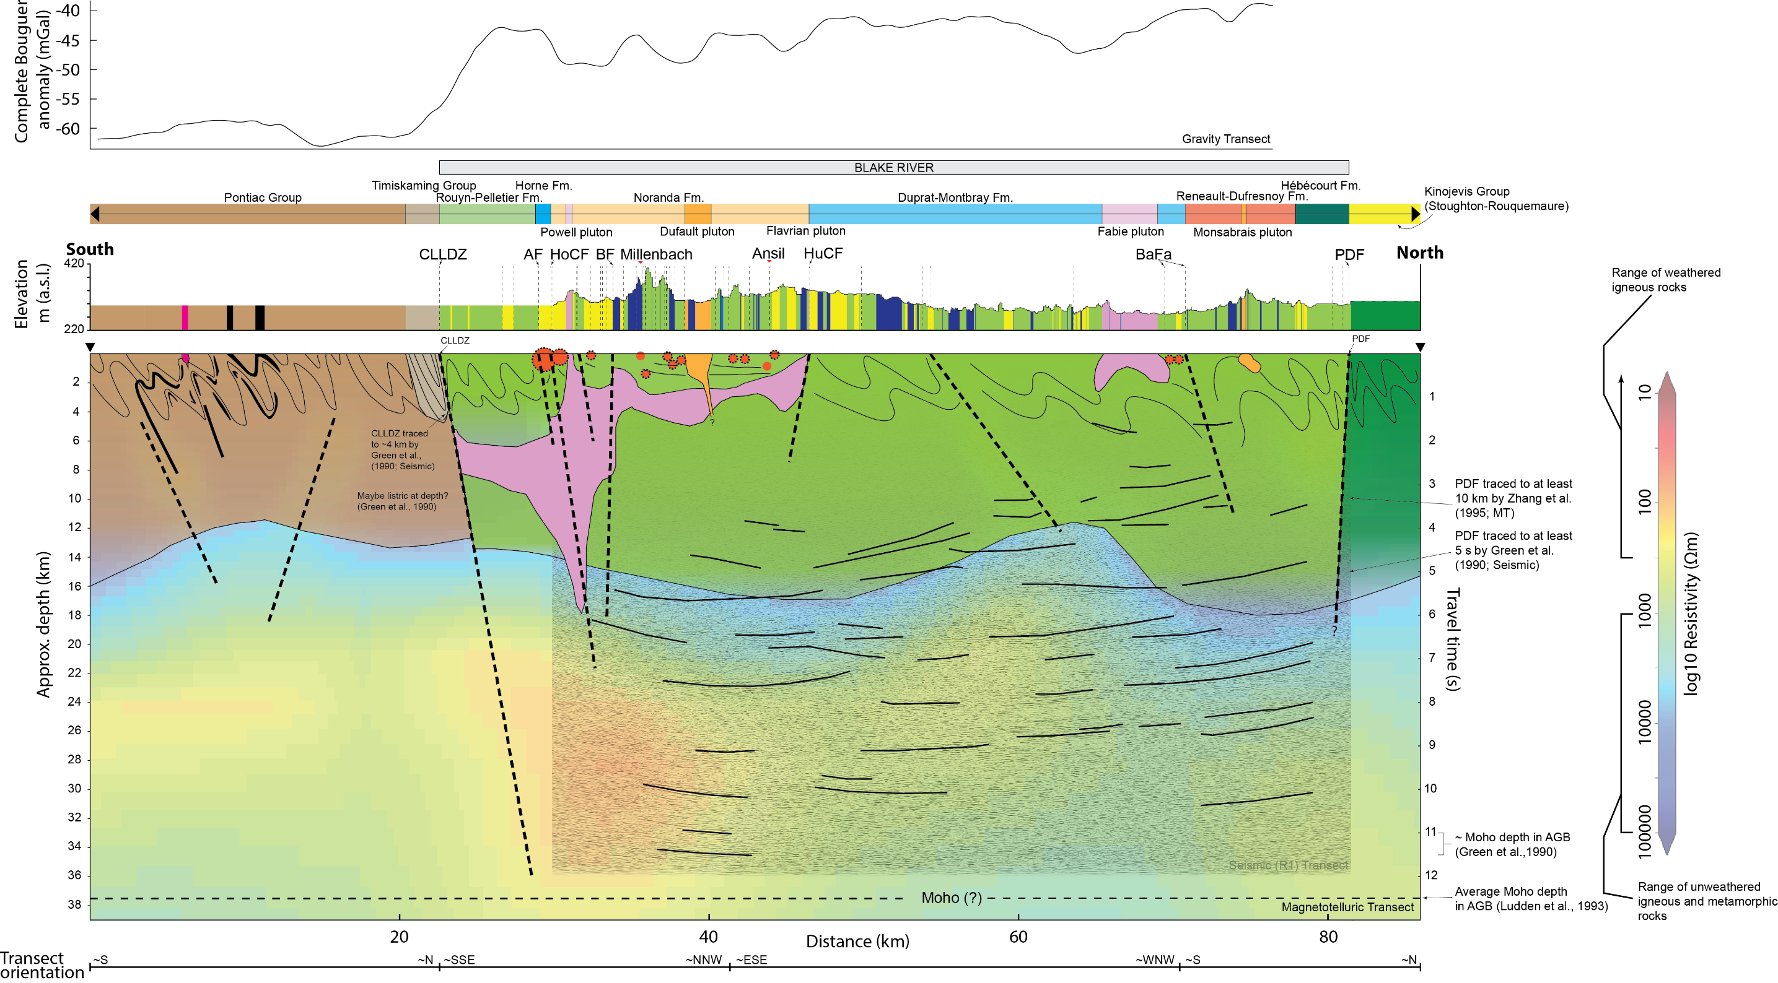
Corresponding asymmetry in geological and geophysical attributes of the Noranda District

Slide 31
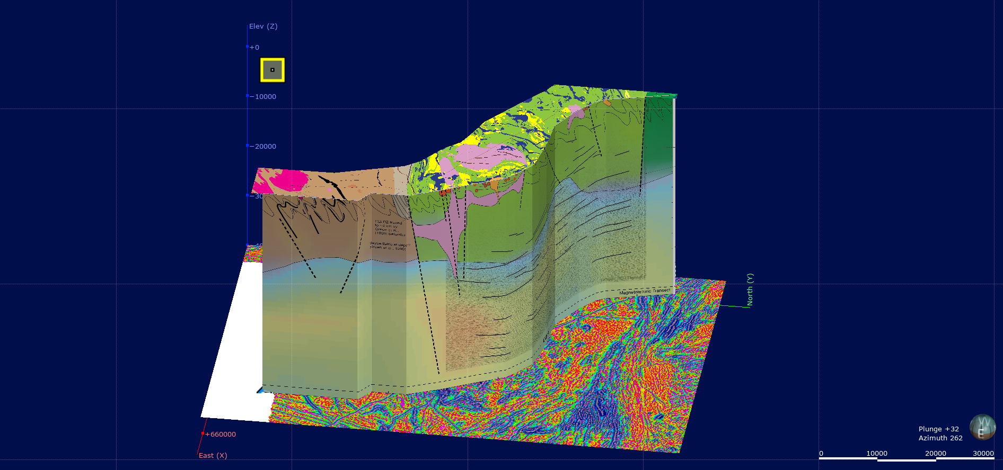

Integrated 3D Noranda Transect

Slide 32
Integrated 3D Noranda Transect
Proximity to a significant crustal structure and splays (CLLB-Horne Creek Fault)
Felsic volcanic centre undergoing extension on margin/periphery of district
Accumulation of a localized, thick volcaniclastic-dominated succession (felsic domes marking fissures)
Horne/Quemont centered on subvolcanic magmatic system

Slide 33
Proximity to transcrustal structures
Mercier-Langevin et al. (2014) – Economic Geology, v. 109, p. 1-9

Slide 34
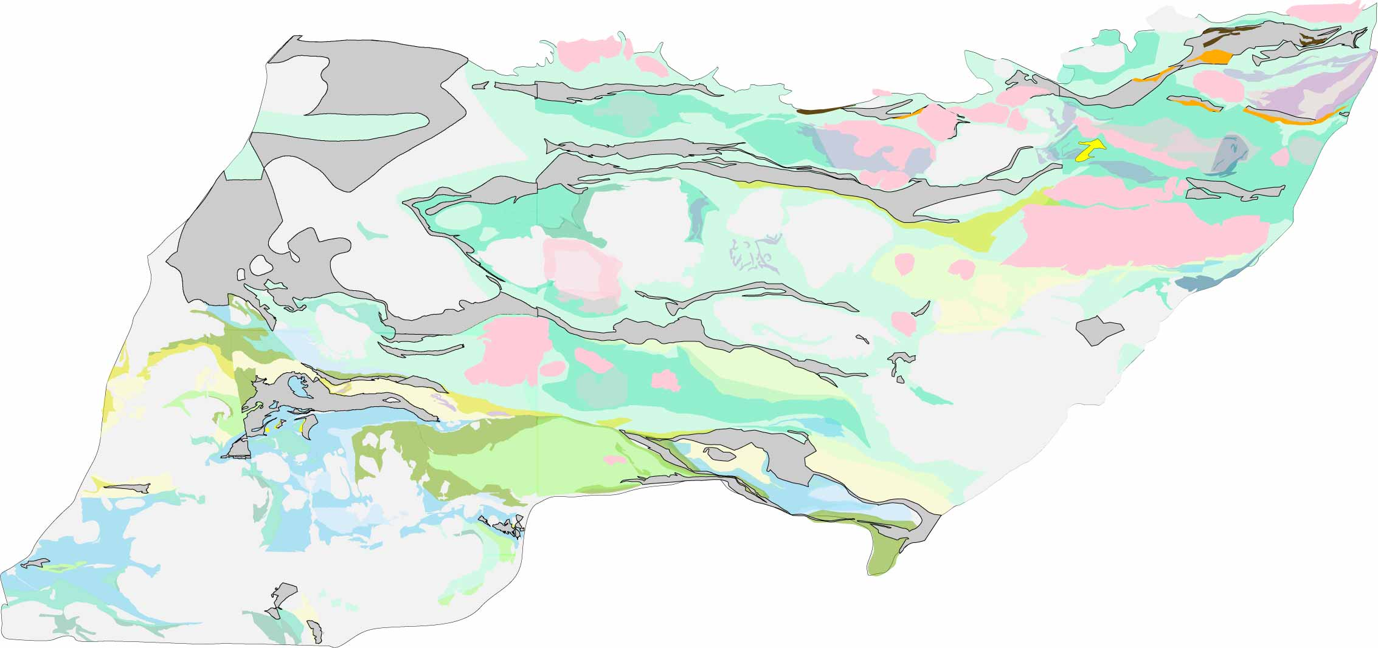
Proximity to transcrustal structures
Widespread sedimentary successions: 2695 – 2685 Ma
Joanisse, 1994; Mueller et al., 1996; Ayer et al., 2002; Davis, 2002; Ayer et al., 2003; David et al., 2012
Turbidites
50 km
Linear distribution of 2695-2685 sedimentary cover = Preservation within early synorogenic extensional basin?
Gibson (2017); Map modified after Goutier et al. (2007)

Slide 35
Proximity to transcrustal structures
Widespread sedimentary successions: 2695 – 2685 Ma
Joanisse, 1994; Mueller et al., 1996; Ayer et al., 2002; Davis, 2002; Ayer et al., 2003; David et al., 2012
Chibougamau
Detour
Fenelon
C-B
Lac Shortt
Turbidites
Douay
Lac Bachelor
50 km
Gold Deposit
Linear distribution of 2695-2685 sedimentary cover = Preservation within early synorogenic extensional basin?
Gibson (2017); Map modified after Goutier et al. (2007)

Slide 36
Proximity to transcrustal structures
Widespread sedimentary successions: 2695 – 2685 Ma
Joanisse, 1994; Mueller et al., 1996; Ayer et al., 2002; Davis, 2002; Ayer et al., 2003; David et al., 2012
Eagle-Telbel
Chibougamau
Detour
Fenelon
C-B
Lac Shortt
Lamoine
2726-29 Ma
Turbidites
Gemini-Turgeon
2736 Ma
Douay
Lac Bachelor
50 km
Estrades
2720 Ma
Horne
2702 Ma
BDL
2698 Ma
Gold Deposit
Cote Lake 2740Ma
Anomalous and Au-Rich VMS
VMS
The linear distribution of sediments reflects synorgenic structures and perhaps older synvolcanic extensional structures?
Modified after Goutier et al., 2007
Gibson (2017); Map modified after Goutier et al. (2007)

Slide 37
Summary and conclusions
Differential metal endowment is observed on the Craton, Belt, and District scales (e.g., Superior vs. Slave; Abitibi vs. Wabigoon; Southern Noranda vs. Northern Noranda)
The Noranda district contains ~20% of known VMS deposits on the Superior Craton, making it a particularly well-endowed VMS district
The asymmetric distribution of VMS deposits, subvolcanic intrusions, and crustal complexity in the Blake River Group of the Noranda district correspond to asymmetric signatures in seismic, MT and gravity profiles
This comprehensive crustal representation summarizes a world-class VMS system and maps deep crustal heterogeneities between endowed and less-endowed areas that might be crucial to make concealed discoveries

Slide 38
Summary and conclusions
Formed from 2740 Ma to 2697 Ma, 33 Ma during construction of the AGB, but 92% of VMS Au formed 2702-2697Ma (5 Ma)
Proximity to fundamental, long-lived (reactivated), trans crustal structures/breaks as defined by the preservation of linear “belts” of synorogenic sedimentary rocks (unconformities), gold occurrences/deposits, deformation, alteration, and alkaline magmatism. Access to well defined, long lived, reactivated fluid-magma pathway. Horne/Quemont centered on a magmatic subvolcanic system adjacent to the transcrustal CLLB.
Are Au-enriched VMS deposits the earliest manifestation of old extensional trans crustal structures that were active during volcanism and then reactivated during orogenic extension and sedimentation and then structurally inverted? Do Au-rich VMS deposits and Au deposits form where these crustal structures access localized areas of metal enriched SCLM, or does proximity to these structures result in local, well defined magmatic fluid pathways?

Slide 39

XYZ
Thank You
Questions?

